Slide 1


RFP Response

Slide 2

Planting The Seed
"One can choose to go back toward safety or forward toward growth.”
- Abraham Maslow

Slide 3
Agenda
2024 Performance
Insights & Research
RFP Response
3 Creative Approaches
Paid Media
Recipes + Influencers
Social Media
Sweepstakes
Content & Website
Pricing & Team
4
10
19
21
39
40
41
42
44
46

Slide 4


What’s Worked

Slide 5
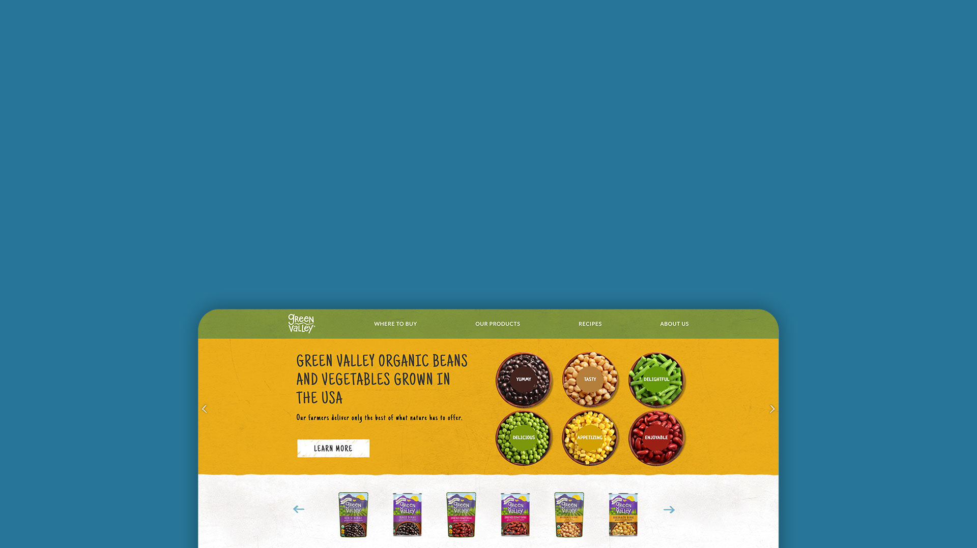
Website Success
There have bean lots of visitors to the valley this past year, exploring our organic offerings, engaging with our story, and discovering recipes.
+172K
+132%
+82%
New Users
More Pageviews
Visits to Product Locator
2023 vs. 2024

Slide 6

Email Success
You've got mail! Email is seeing un-bean-ievable performance. With a qualified and engaged list of +37k subscribers, click rates remain high and open rates blew way past industry benchmarks for the second year in a row.
18%
55%
Avg. Industry Open Rate
Open Rate
+10%
+16%
List Increase
YoY Increase
2023 vs. 2024

Slide 7
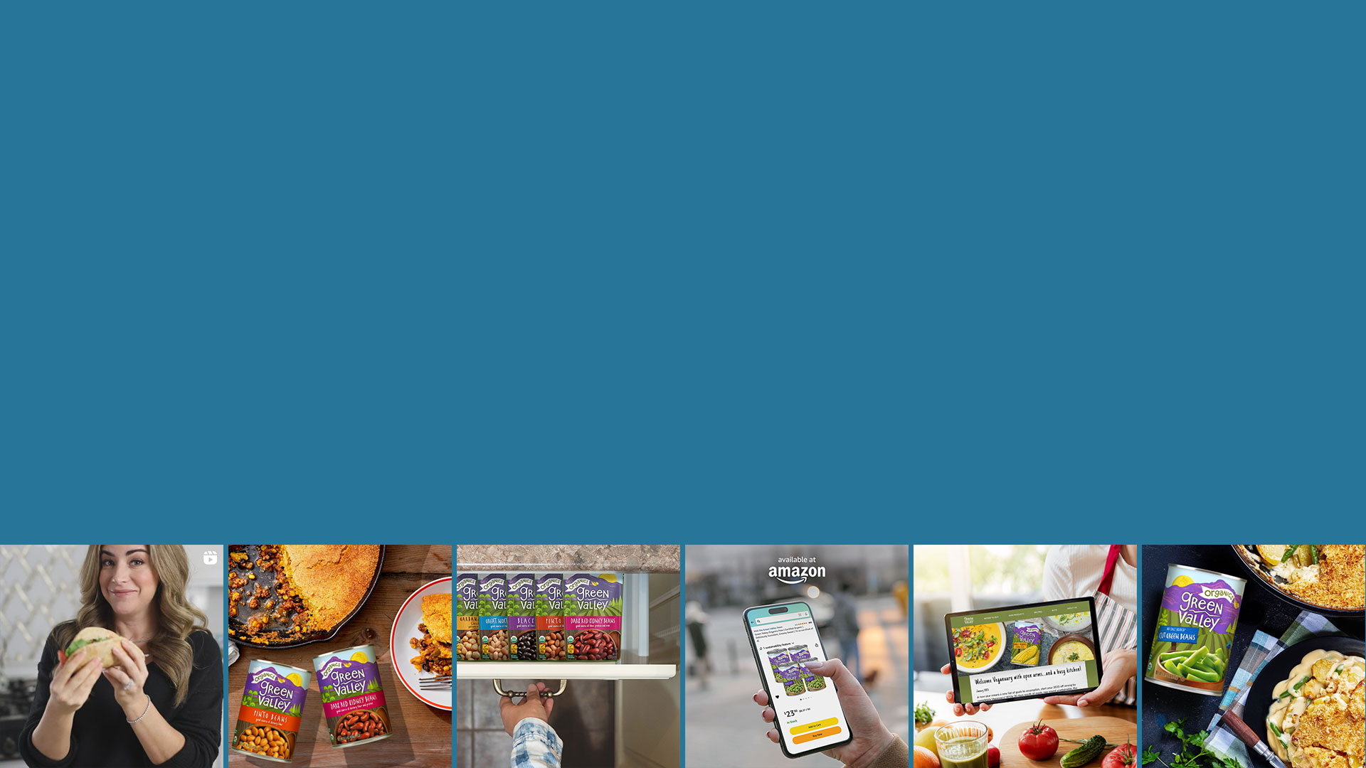
Social Media Success
We're spilling the beans! Social media has seen amazing engagement this year, proving that people love connecting over real, organic goodness from Green Valley.
+41.3%
+40.6%
+140%
Engagement Rate
Engagement Total
More Comments
YoY

Slide 8
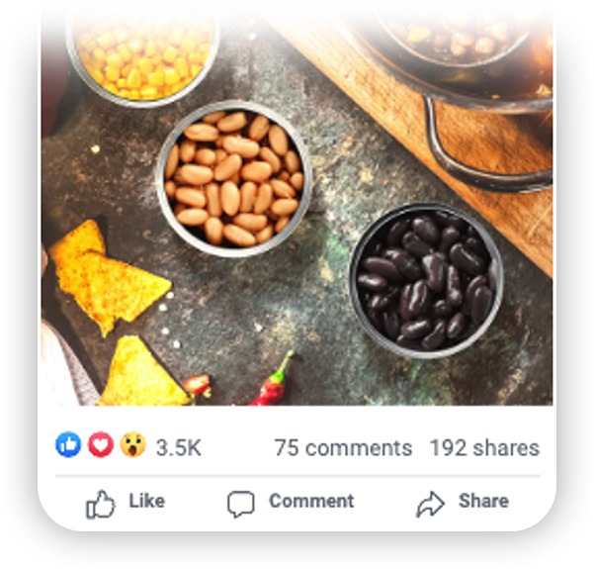

FY2024 Paid Media Success
More beans for your buck! Paid Media efforts have seen great results, garnering more clicks, adding sales, and increasing efficiencies.
280K
+95%
7.7x
Landing Page Views
YoY Click-Thu Rate
Instacart Return on Ad Spend
155K
-42%
Social Engagements
YoY Cost per Click

Slide 9


Sweepstakes Success
During peak PSL season, we captured the pumpkin-momentum with a social-led Pumpkin Moments Sweepstakes. Our objective was to increase engagement on social media and expand our email list over a six-week period. We enhanced and boosted our social media posts to maximize reach and virality, ensuring impressive results.
+21K
16K
168K
1K+
Total Entries
Site Visits
Total Impressions
Comments

Slide 10
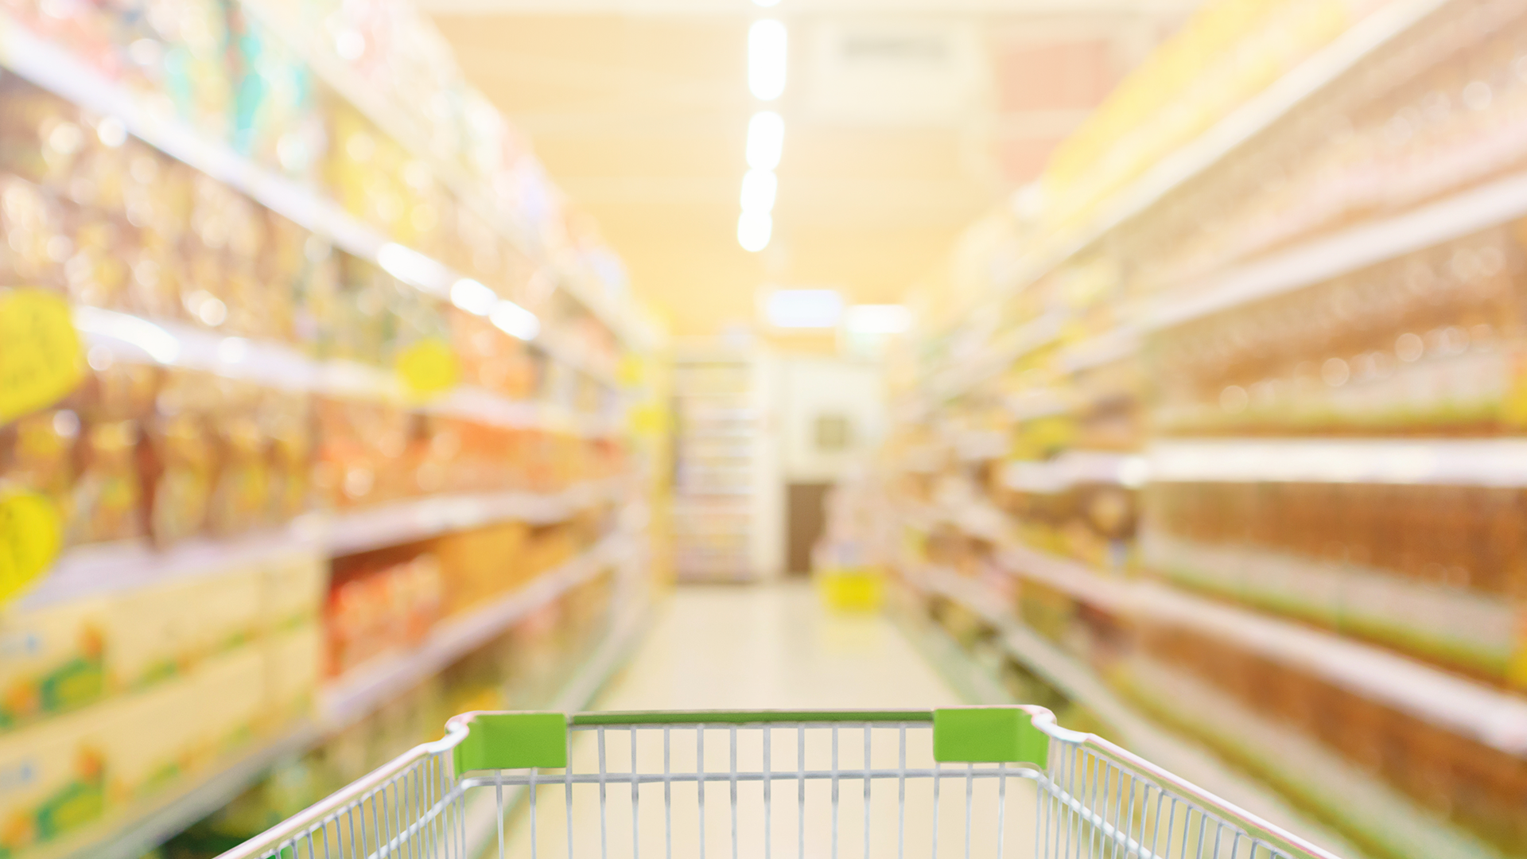
How can we address the
Organic Consumers' Dilemma?
Notes:
How do we standout?

Slide 11
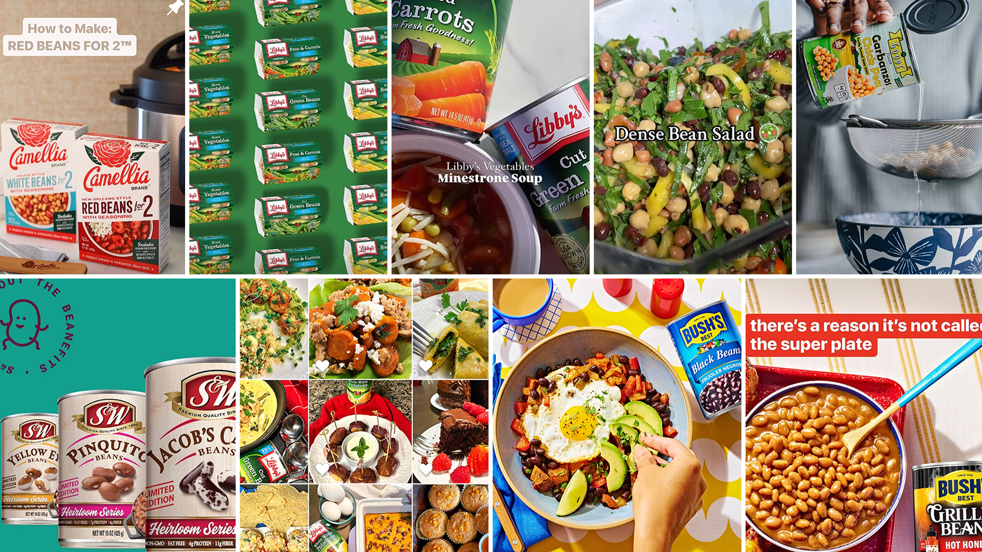
How to Stand Out From Shelf to Site to Social
Consumers are met with a sea of sameness in the organic bean and vegetable space from the product to the store to marketing. Establishing a new connection will win hearts and dollars.
11

Slide 12
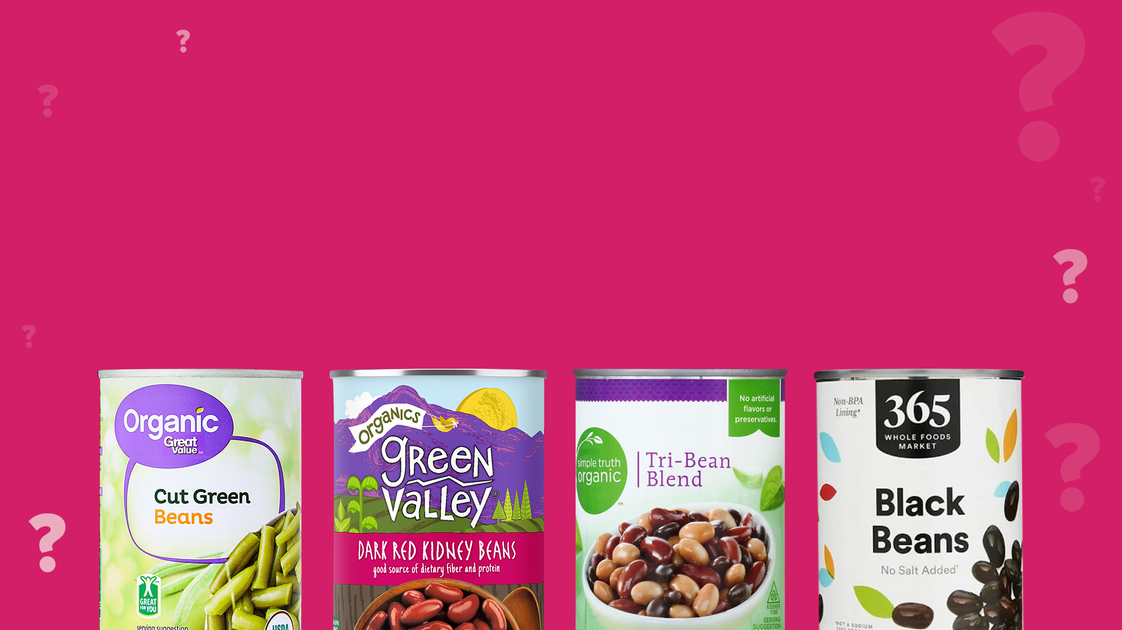
Not All Cans Are Created Equal
Consumers shopping for organic canned vegetables often assume that all brands offer the same quality, but the reality is different.
Some brands cut corners—using additives, preservatives, or lower-quality vegetables—but Green Valley Organics holds itself to higher standards.
The challenge? Consumers don’t always know what to look for.
They want clean, high-quality organic food, but price, labels, and marketing noise make decision-making harder.

Slide 13
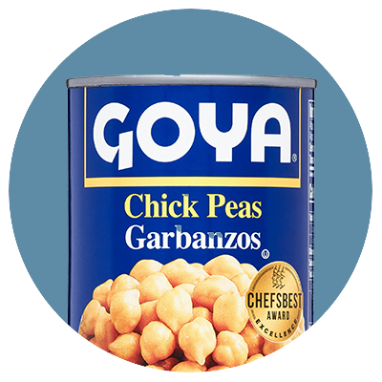
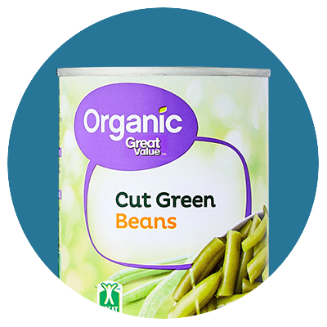
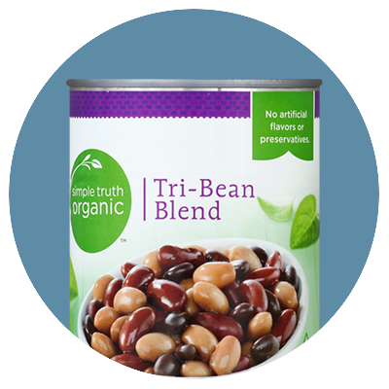
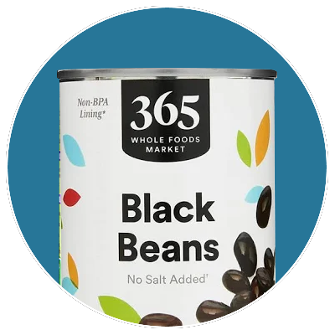
What Makes Each Can Different?
When we take a closer look into each can, much of what we see in the organics space IS the same. How does each brand set themselves apart?
 | - Ingredients: Varies; may include additional preservatives or firming agents - Sodium Content: Higher compared to Green Valley Organics - Processing: Standard commercial canning practices - Packaging: BPA usage not specified | Celebrates traditional Latin flavors and recipes. Emphasizes the brand's roots and connection to Latin culture. Highlights the use of quality ingredients in their products. Engages with the Hispanic community through various initiatives.
 | - Ingredients: Organic vegetables, water, sea salt - Sodium Content: Comparable to Green Valley Organics - Processing: Standard organic canning practices - Packaging: BPA usage not specified | Emphasizes low prices for organic products. Highlights widespread availability across numerous locations. Offers a broad selection of organic products. Focuses on easy-to-use products for everyday cooking.
 | - Ingredients: Organic vegetables, water, sea salt - Sodium Content: Varies; some products may have higher sodium levels - Processing: Standard organic canning practices - Packaging: BPA usage not specified | Offers a wide range of natural and organic products. Positions products as budget-friendly without compromising quality. Focuses on products free from artificial preservatives and ingredients. Provides clear labeling to help consumers make informed choices.
 | - Ingredients: Organic vegetables, water, sea salt - Sodium Content: Generally low; offers no-salt-added options - Processing: Canned at peak freshness - Packaging: BPA-free cans for certain products | Emphasizes high-quality organic and natural products at accessible prices. Focuses on clear labeling and sourcing information to build consumer trust. Highlights environmentally friendly practices and products. Promotes local community involvement and support.
Notes:
A Look At the Labels … A Look Inside the Can

Slide 14

Some Brands Focus on What's in the Can…
When talking to consumers, some brands stick to messaging only about the tangible aspects of the products. They focus on content that speaks to the mind of the consumers like:
Minimal Processing:
Low Sodium Options:
Peak Harvesting:
Clear Labeling:
Certifications:
Farming Practices:
Products contain only organic vegetables, water, and sea salt, ensuring no unnecessary additives or preservatives.
Offer no-salt-added varieties, allowing consumers to manage their sodium intake effectively.
Vegetables are harvested at their nutritional peak and promptly canned to preserve maximum flavor and nutrients.
Detailed information about our sourcing and production processes, building consumer trust through transparency is provided.
Products are certified organic and adhere to stringent quality standards, reinforcing the commitment to excellence.
Dedicated to excellence, which is reflected in the adherence to the best organic farming practices
Notes:
Shorten the copy, change copy color
Blue on one slide, yellow on another slide....break up too much copy

Slide 15

While Others Focus Outside of the Can.
Some brands anchor their messaging on topics that speak to the heart of the consumers to make a more emotional connection. They highlight:
Affordability:
Convenience:
Family-Centric Values:
Authentic Storytelling:
Strive to make high-quality organic foods accessible to all, offering nutritious options at reasonable prices.
Ready-to-use canned vegetables simplify meal preparation, providing healthy solutions for busy families without compromising on quality.
Emphasize the joy of sharing wholesome meals, fostering a sense of community and connection among the consumers.
Invite consumers to join in embracing a lifestyle that values health, sustainability, and the simple pleasures of home-cooked meals.
Notes:
Shorten the copy, change copy color
Blue on one slide, yellow on another slide....break up too much copy

Slide 16


Where Does Green Valley Win?
Our opportunity lies in the perfect balance—the unmatched quality inside every can and the meaningful moments it helps create. Connecting with Green Valley consumers' hearts and minds will lead them to Look for the Valley in store.
Minimal Processing
Affordability
Peak Harvesting
Convenience
Low Sodium Options
Certifications
Family-Centric Values
Farming Practices
Clear Labeling
Authentic Storytelling

Slide 17

Heading into 2025-26
Responding to the RFP

Slide 18

Build Brand Awareness with a New Brand Campaign
Graphic design, photography, and video
Taglines and copywriting
Paid Media Amplification
Drive traffic to the website
Drive foot traffic to stores
Increase orders via shopping sites
Website Refresh
Create a new look and brand representation for Green Valley
Provide ongoing refresh support and seasonal updates
Optimize SEO and SEM capabilities
Green Valley Goals + RFP Request
Reinvigorate Social Media
Focus on growing followership and engagement on FB, IG, and Pinterest
Recipe Development Program
Original recipe writing and high-quality photography
Update Recipe Section on website

Slide 19

2025 Brand Awareness Campaign

Slide 20
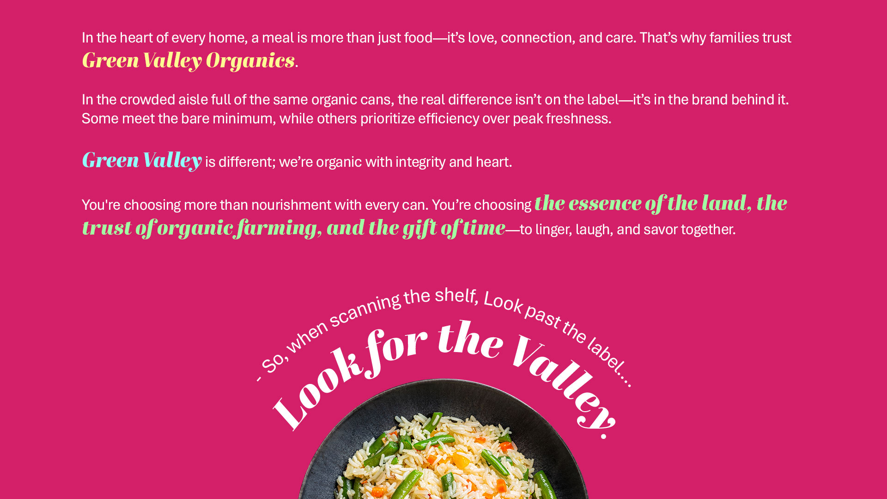
Notes:
the action we want the shopper to take
In the sea of sameness where all cans are created equal… heart and mind connect

Slide 21

Creative Exploration
We've put together 3 creative options that each bring Look for the Valley to life in different ways. Each has a distinct vibe, but all stay true to the Green Valley brand and work hard to promote the valley at all touchpoints, ensuring that wherever consumers encounter the brand, they feel the warmth, authenticity, and natural goodness that set it apart.
21

Slide 22

Creative Option 1
Notes:
Look for the Valley -> Pop into the Valley

Slide 23
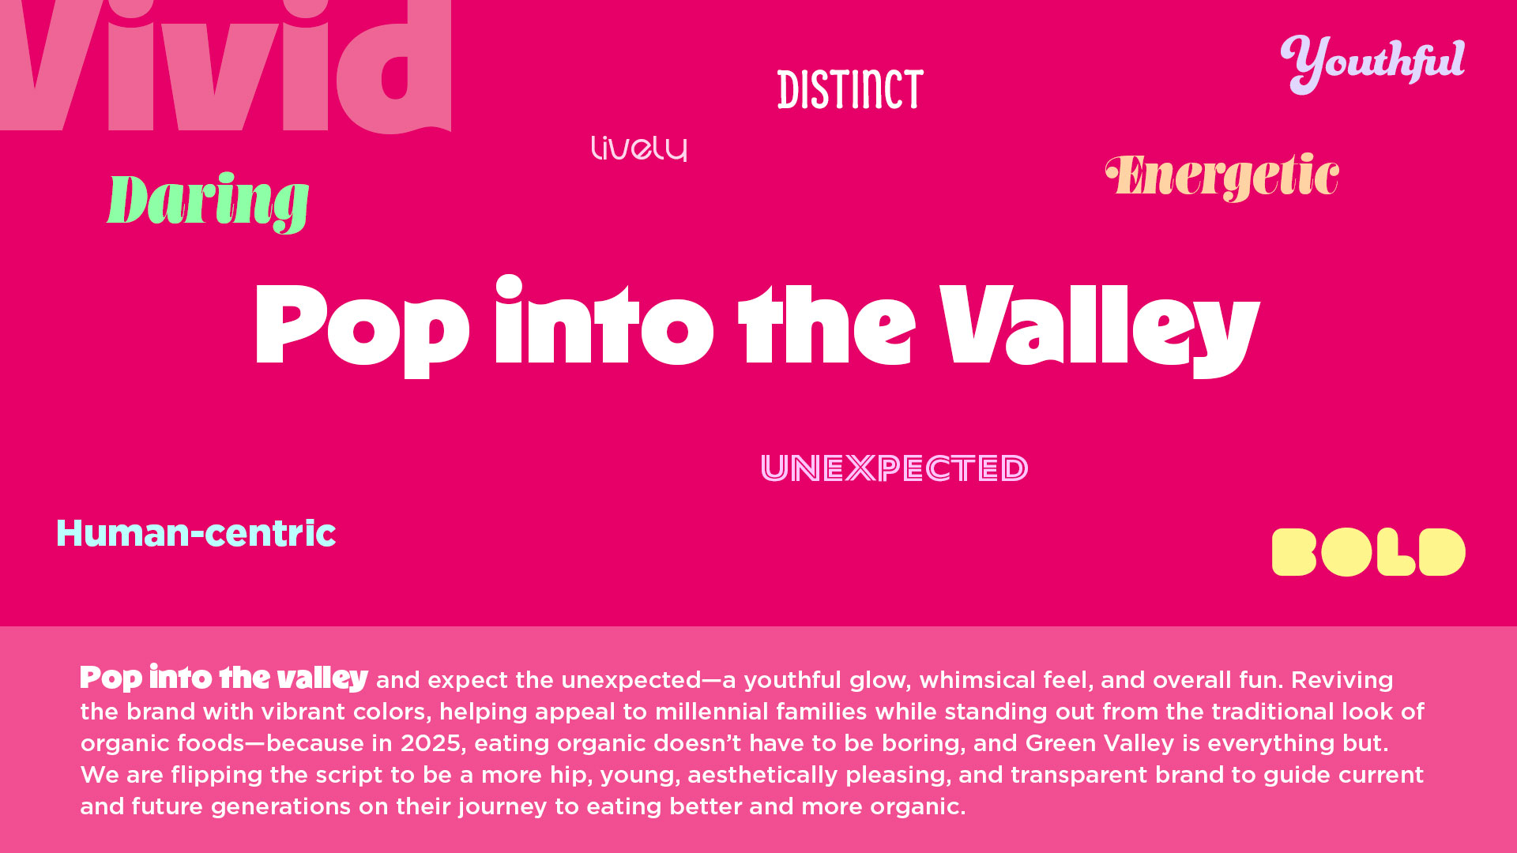

Slide 24
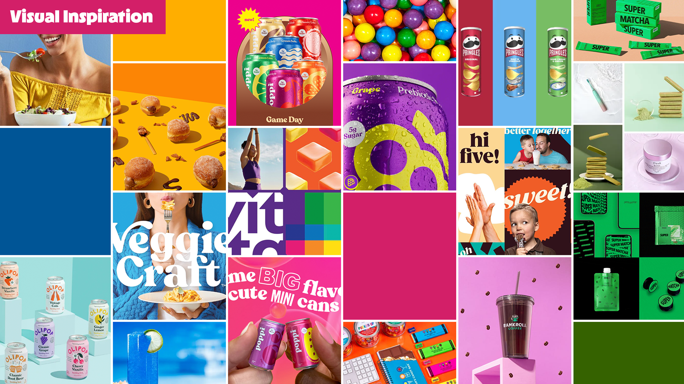

Slide 25


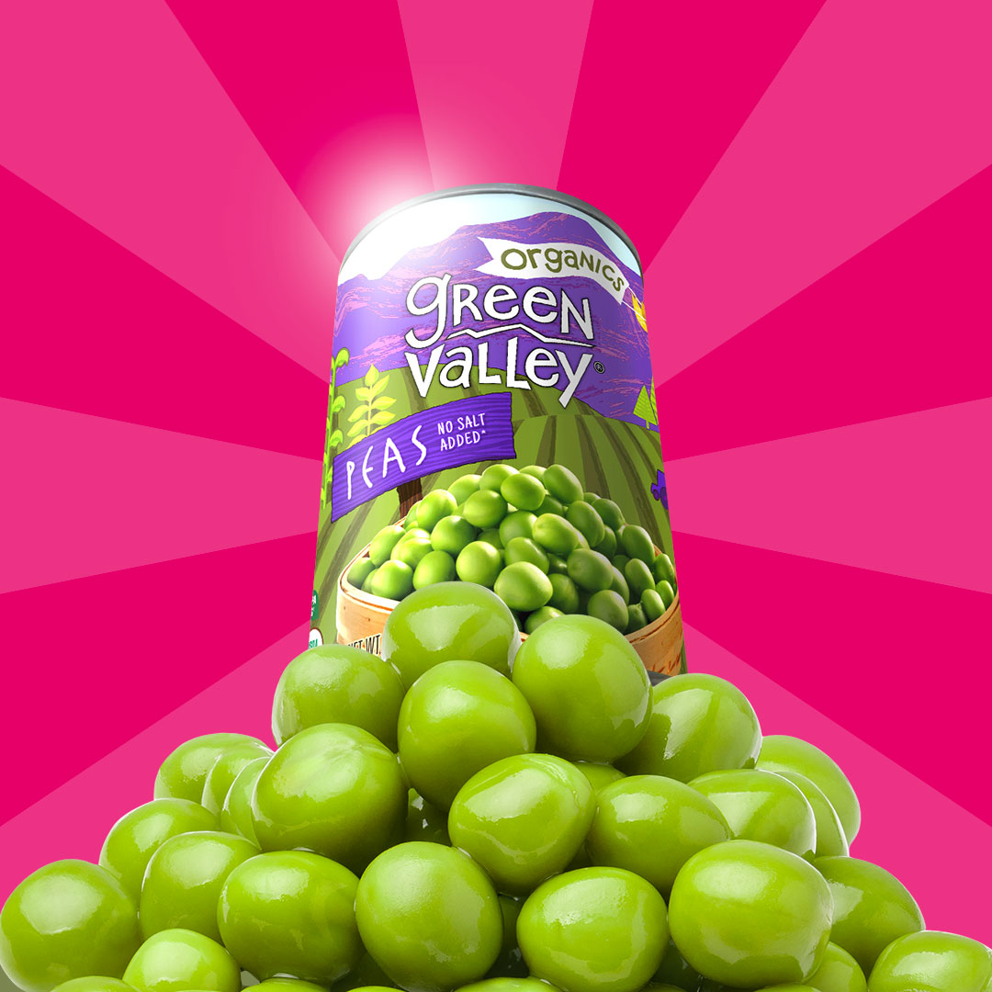
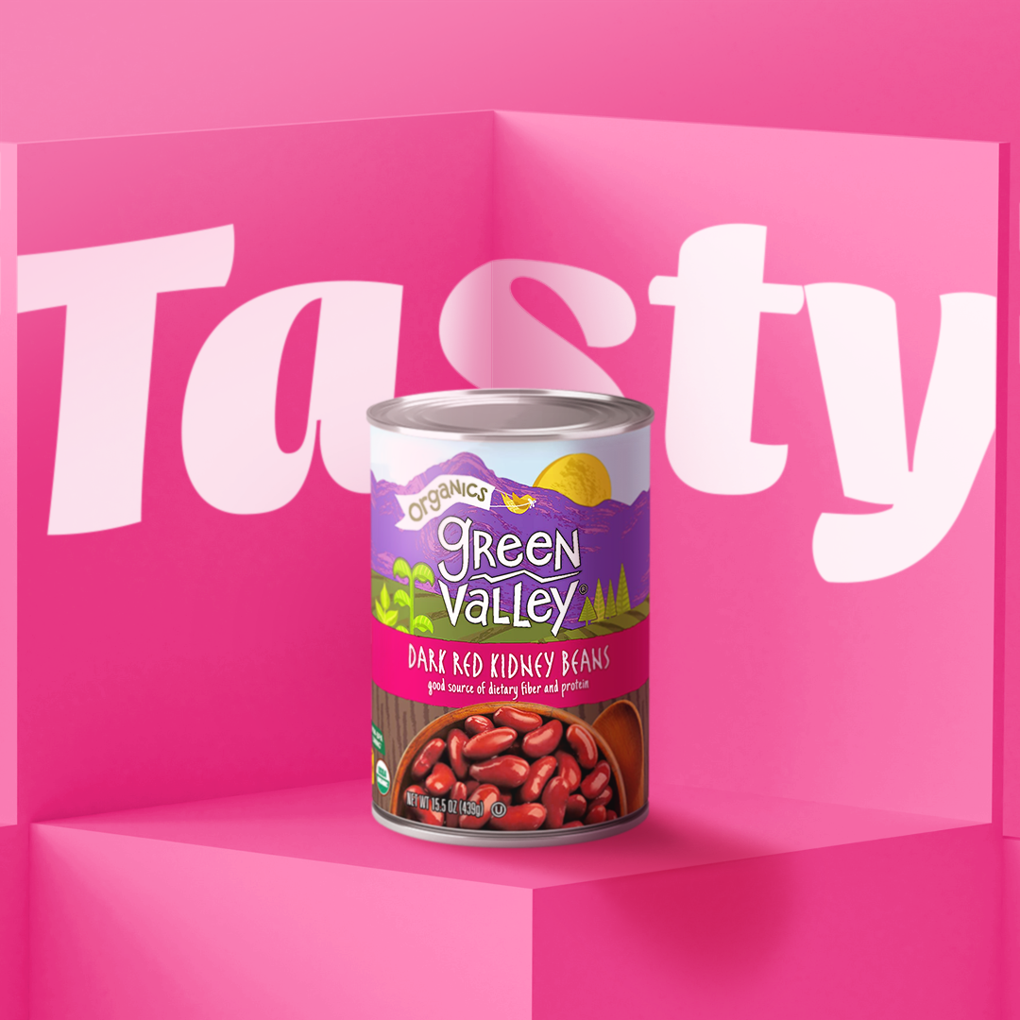
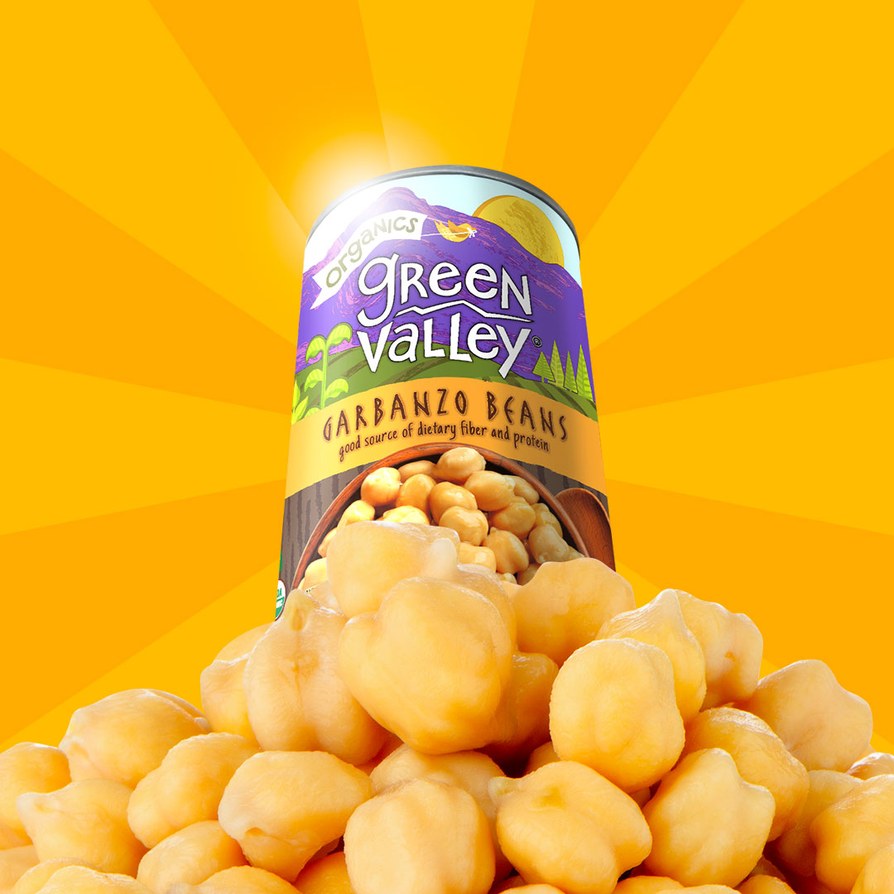
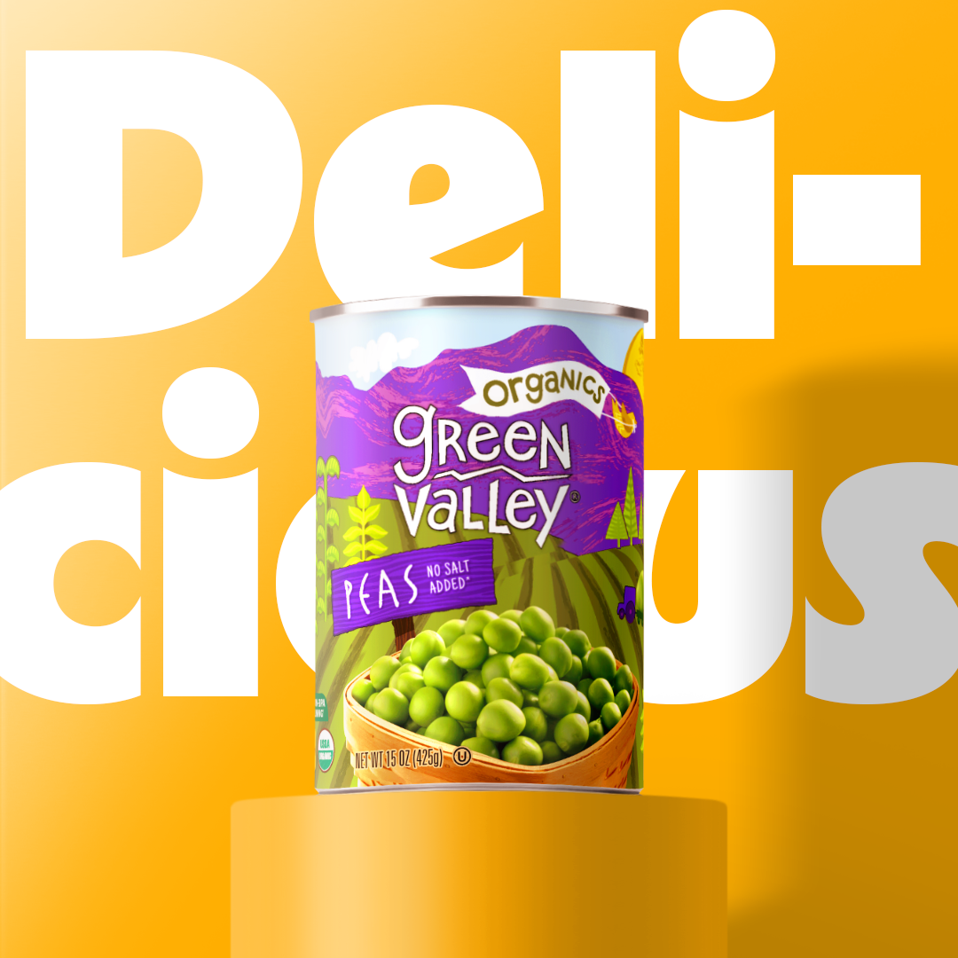
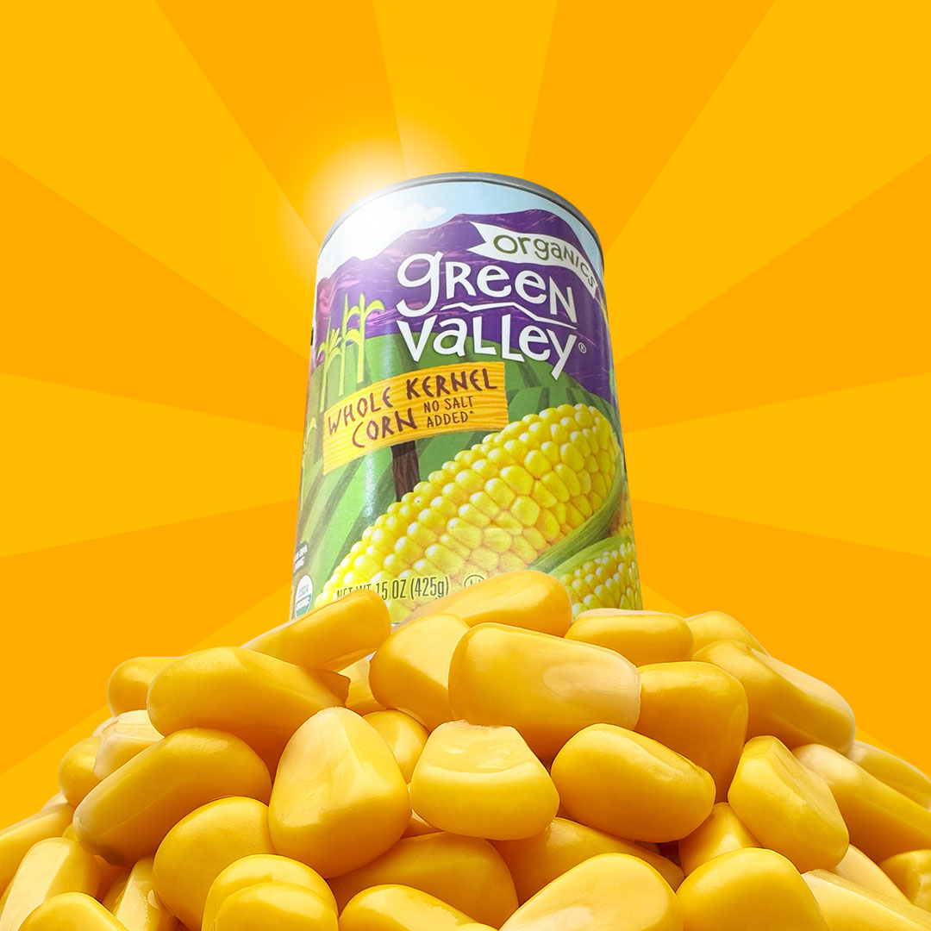
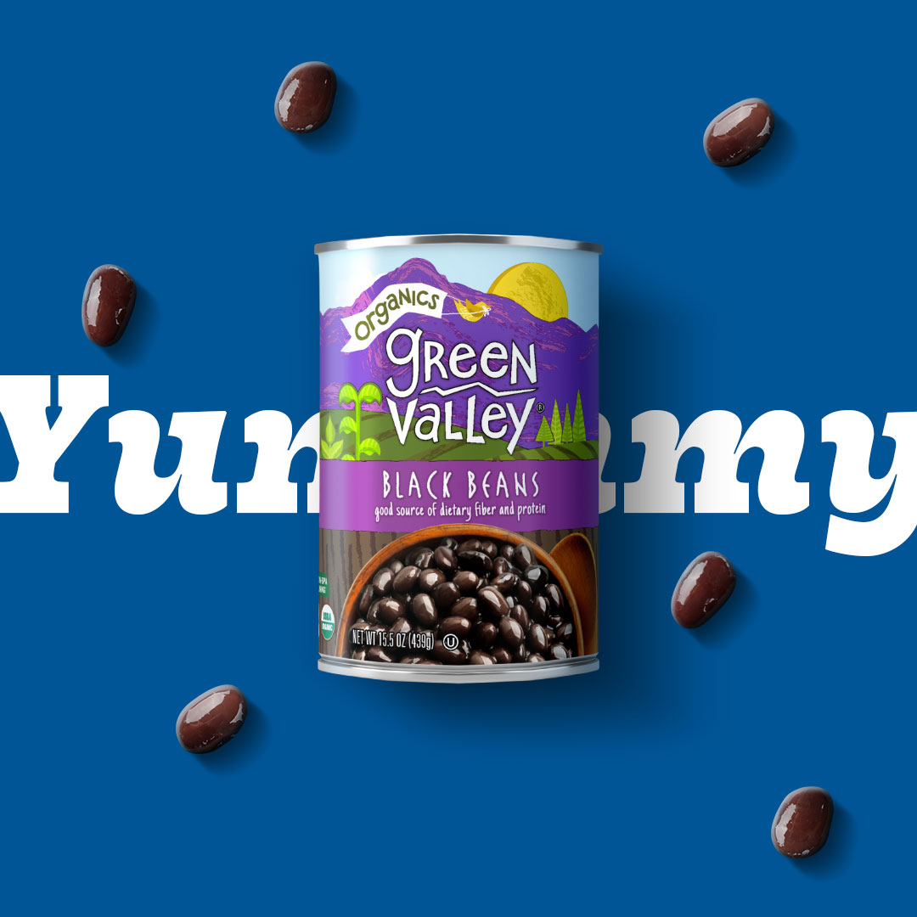
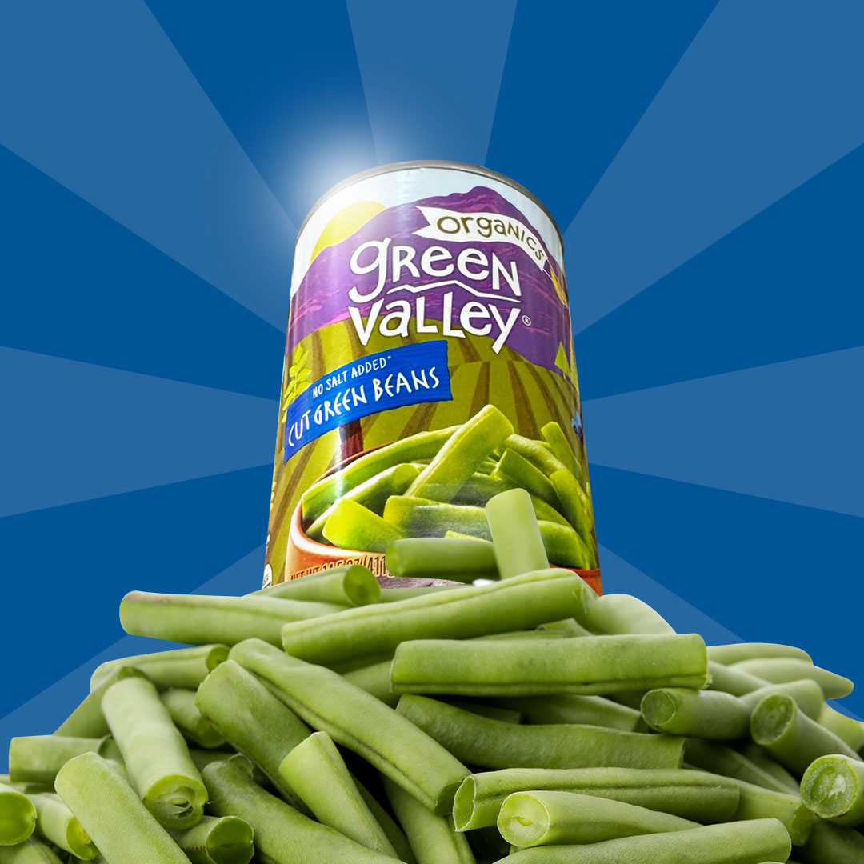
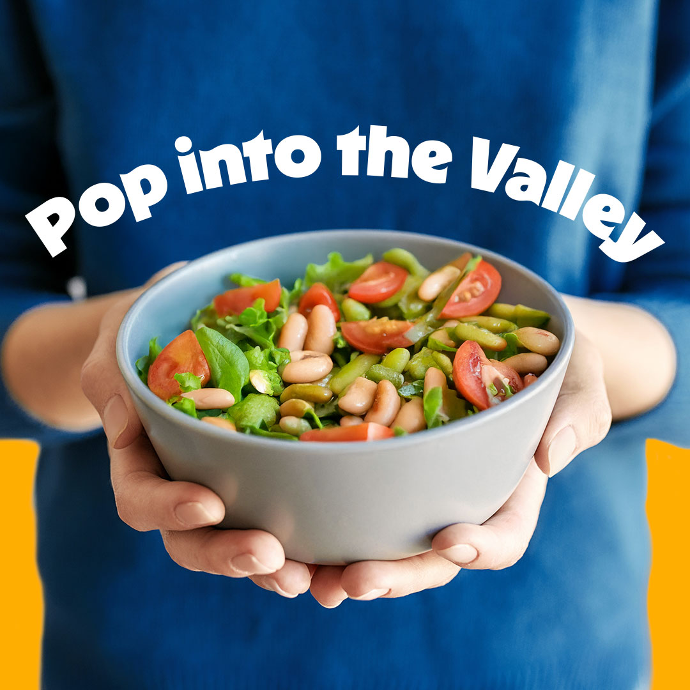

Slide 26
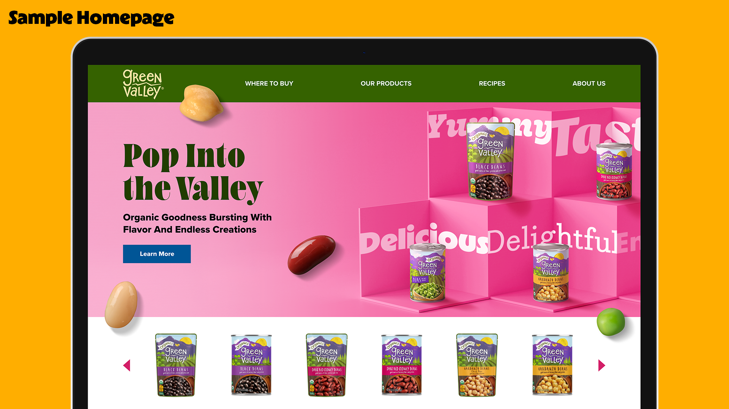

Slide 27

Creative Option 2

Slide 28
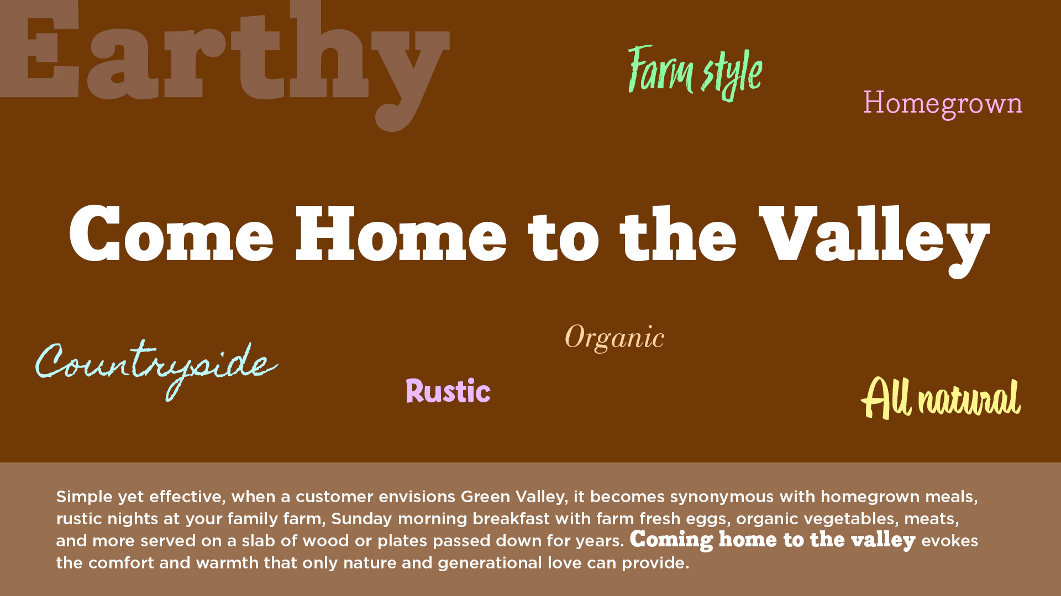
Notes:
Come Home to the Valley

Slide 29

29

Slide 30


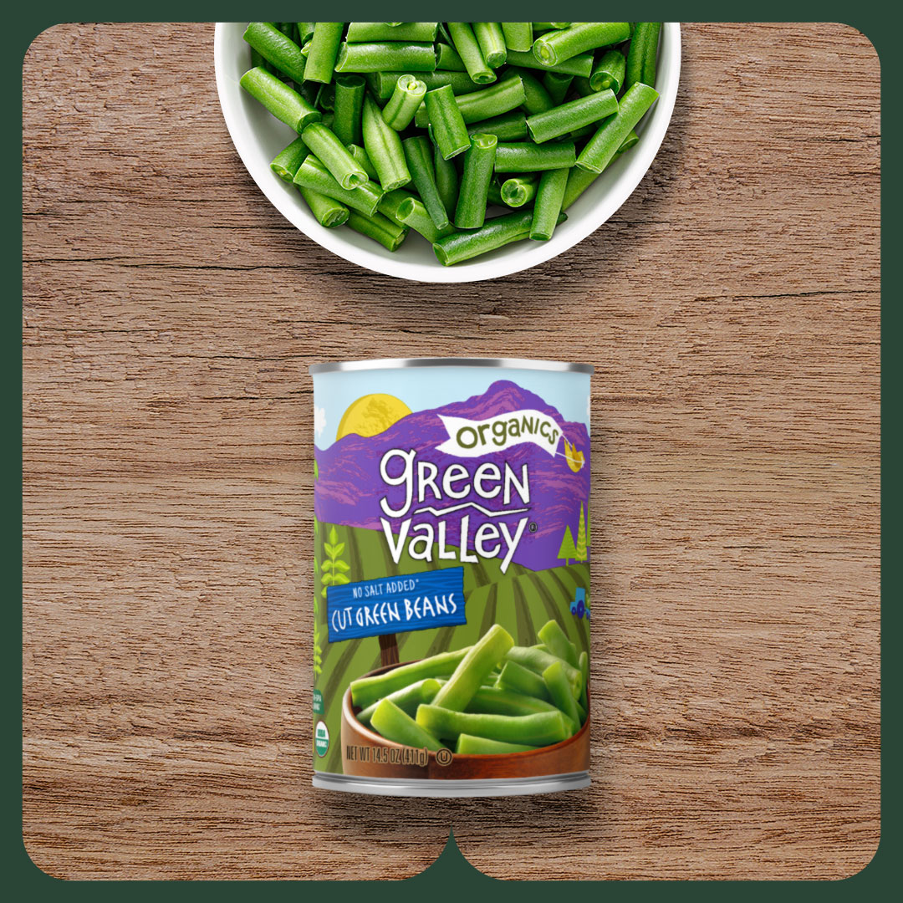
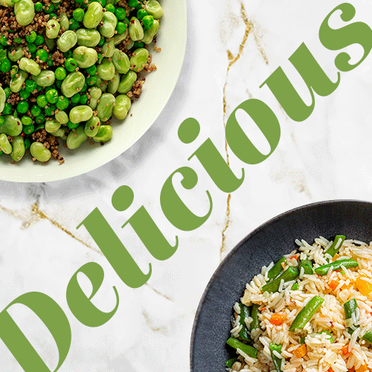
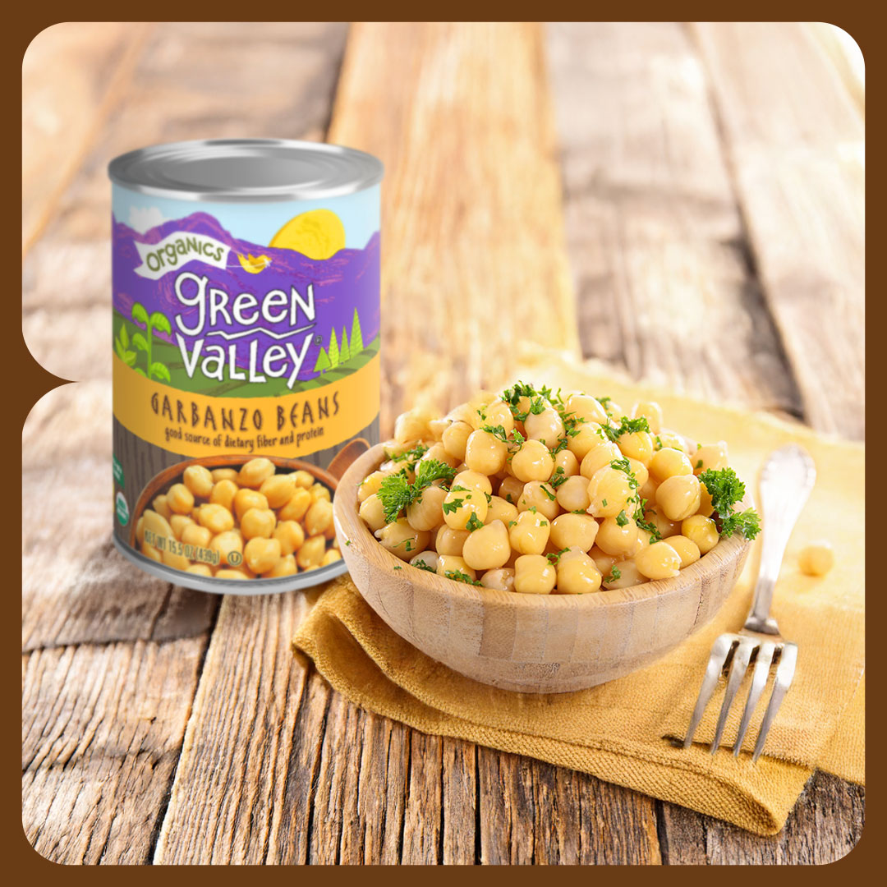
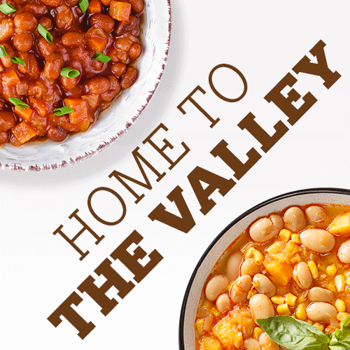
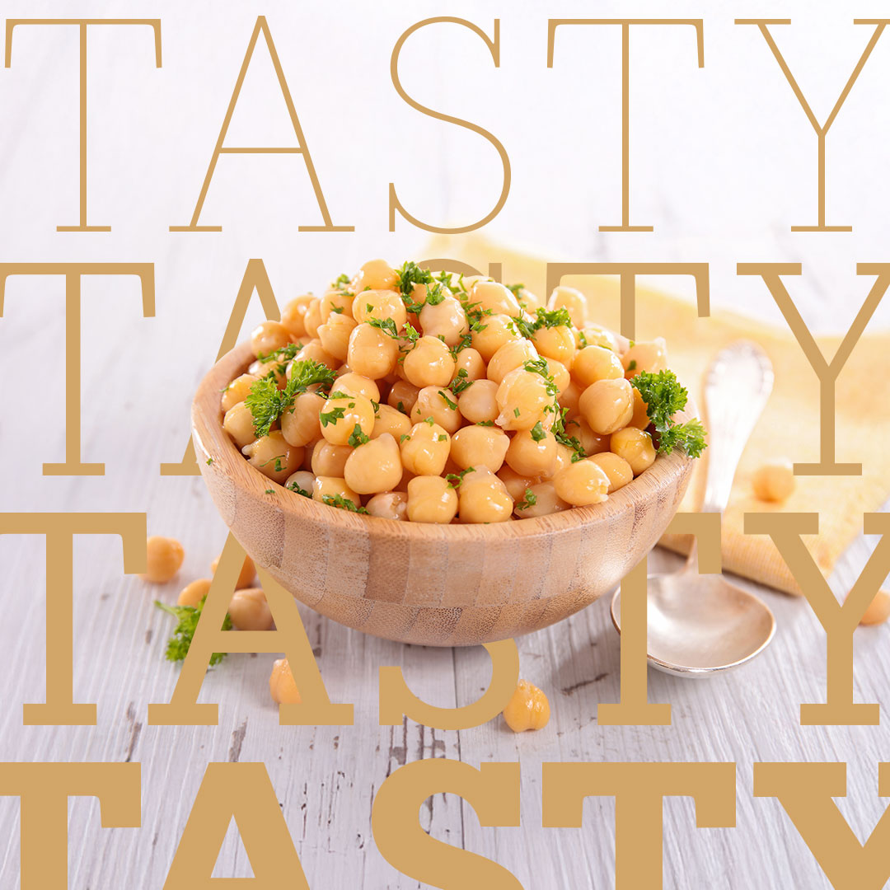
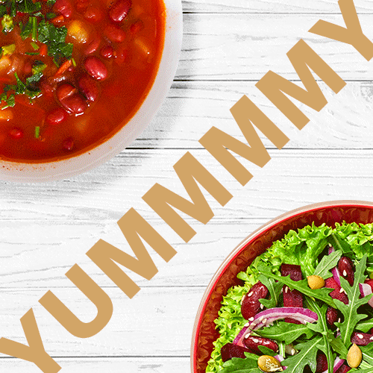
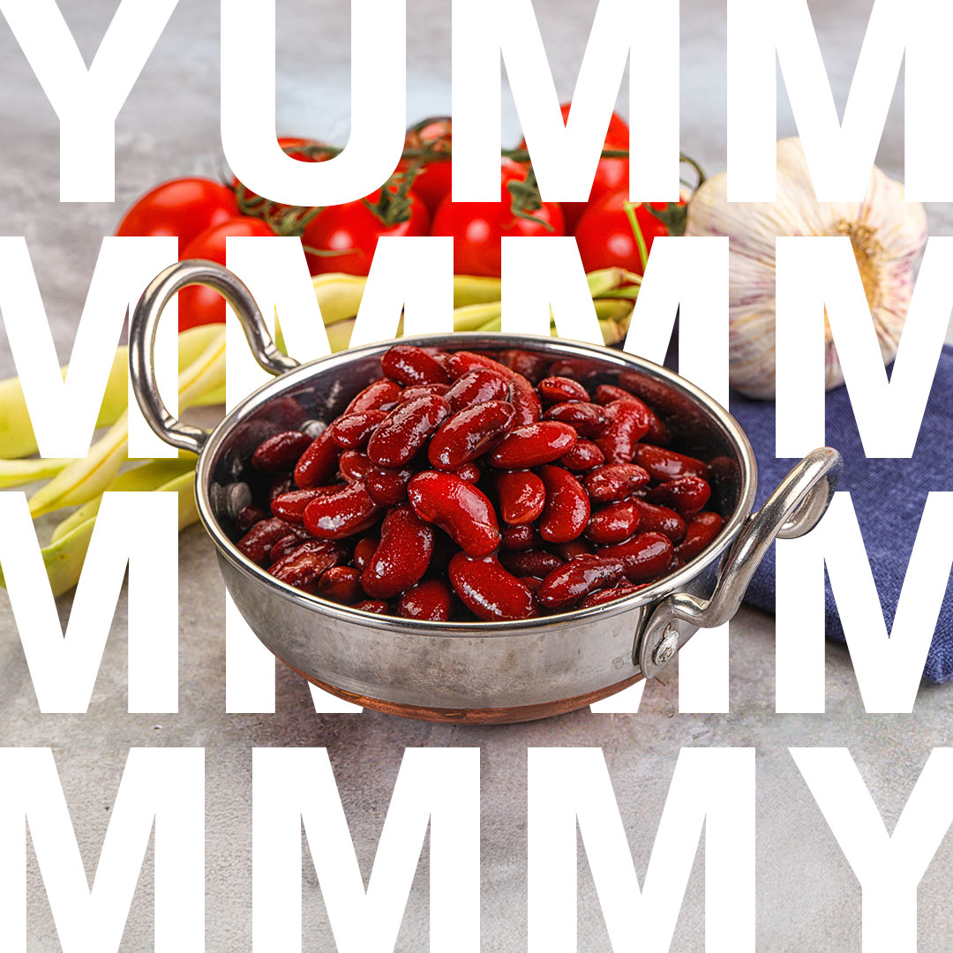
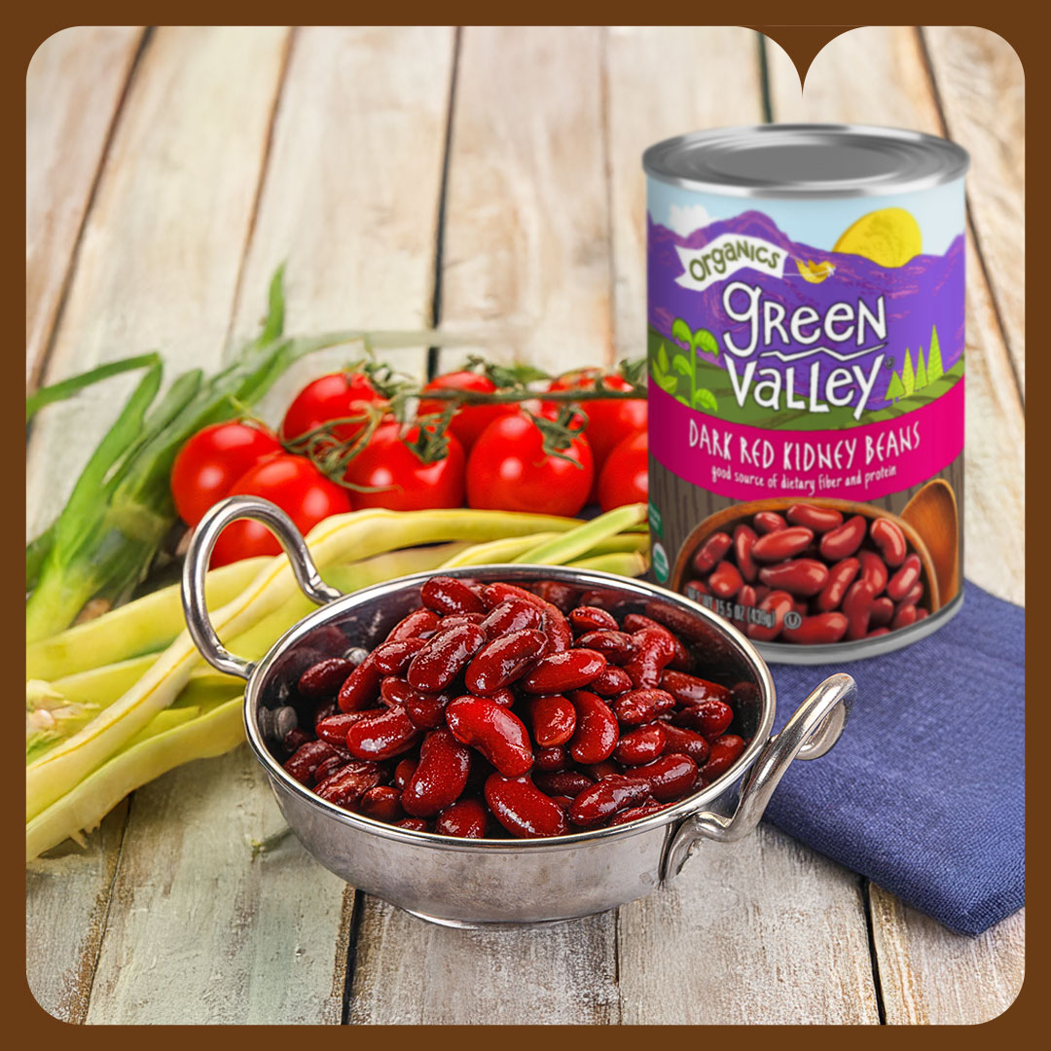

Slide 31
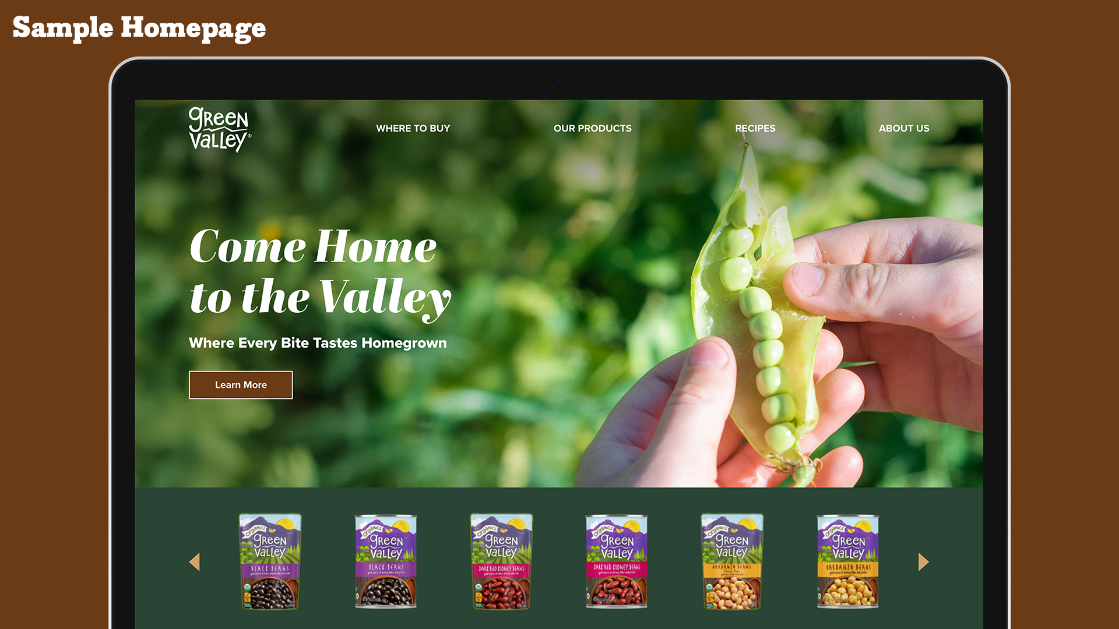

Slide 32

Creative Option 3

Slide 33
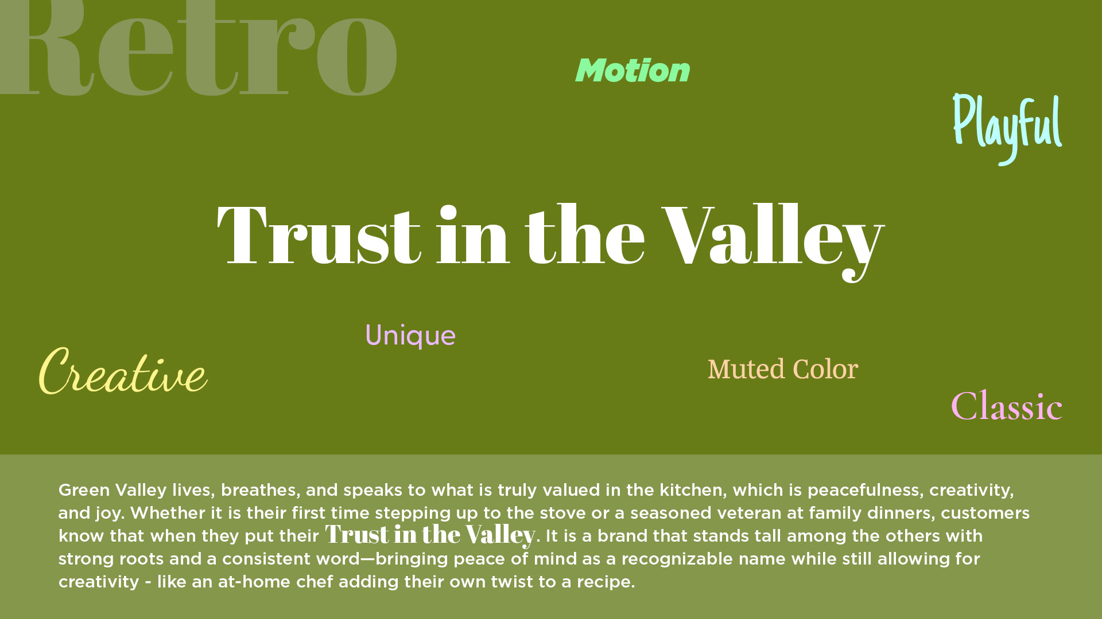
Notes:
Remember the Valley

Slide 34
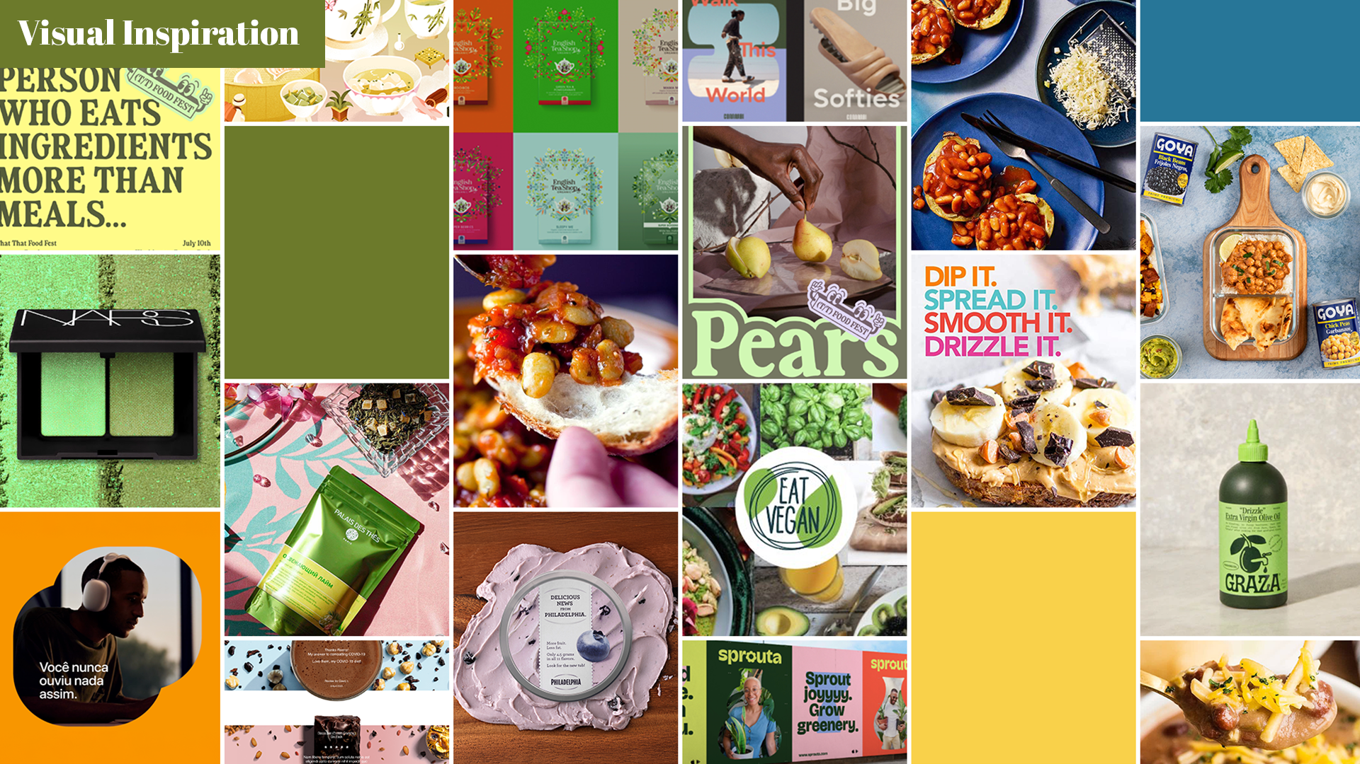
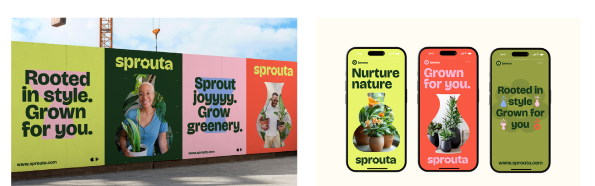






Just throwing in 2 design style ideas Roeni/Nancy came across – not sure which creative avenue it may go with so just dropping here
Whimiscal illustration– bright colors/new take on the illustration style of current site
Inspo website: https://www.graza.co/
Cut out – shapes could be the outline of the mountians/valley or the shape of the beens/pumpklin
Notes:
Add fun words, copy, creative call outs

Slide 35

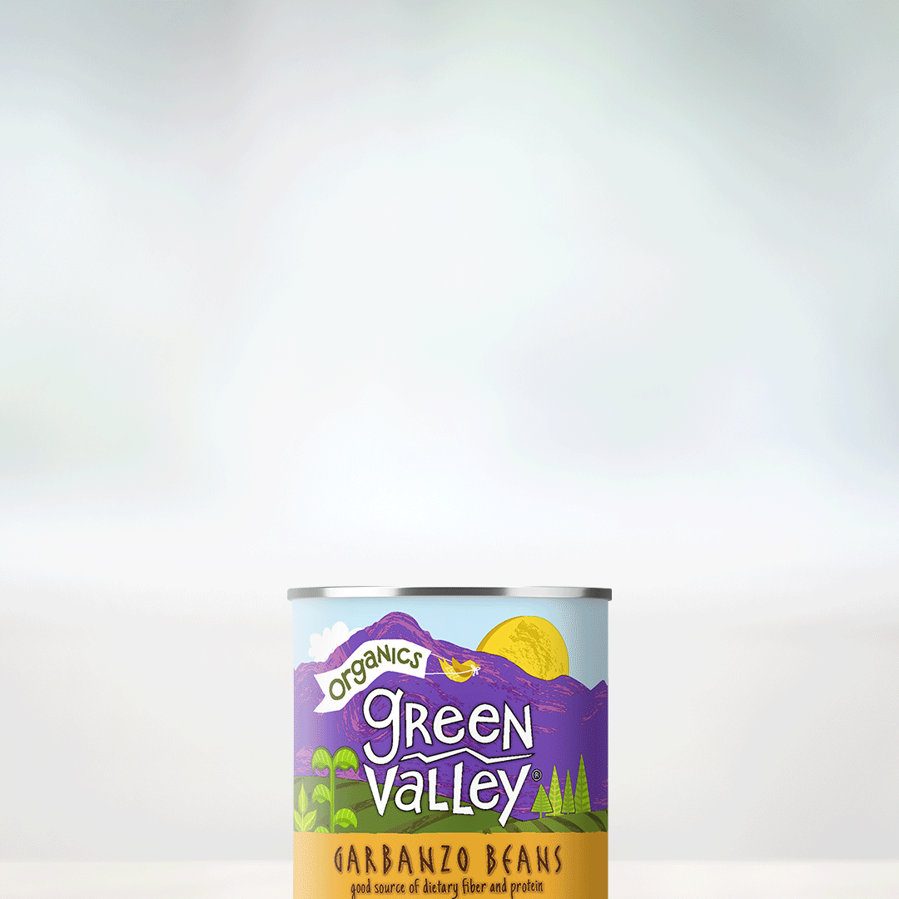
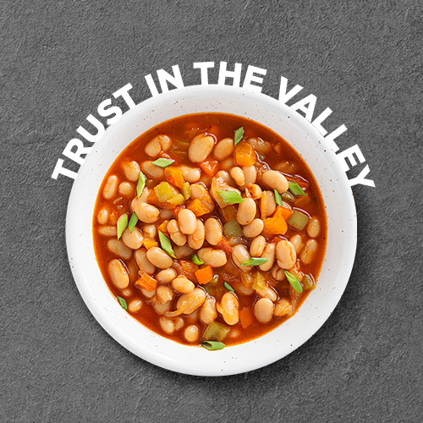
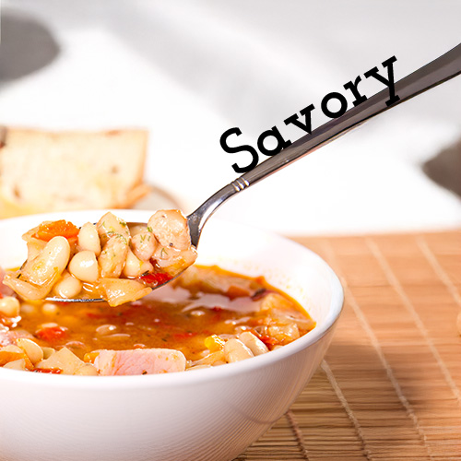
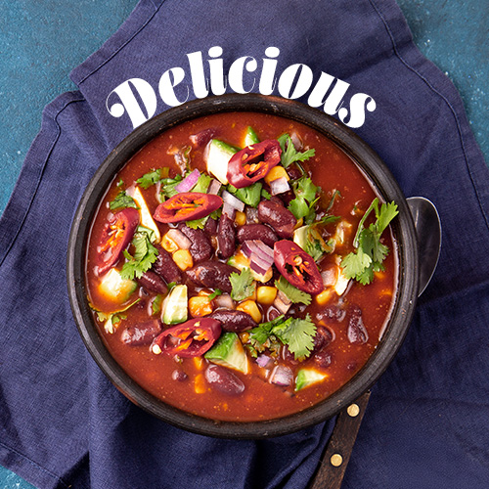
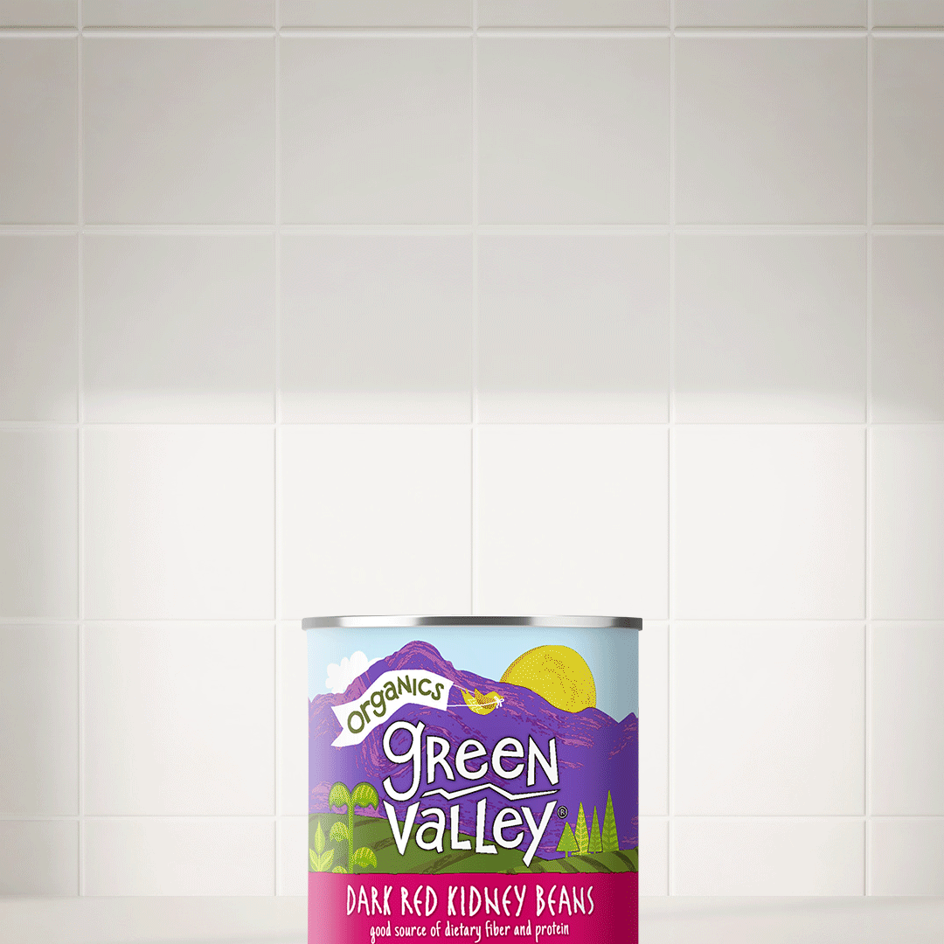
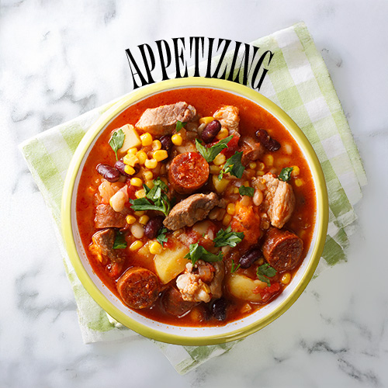
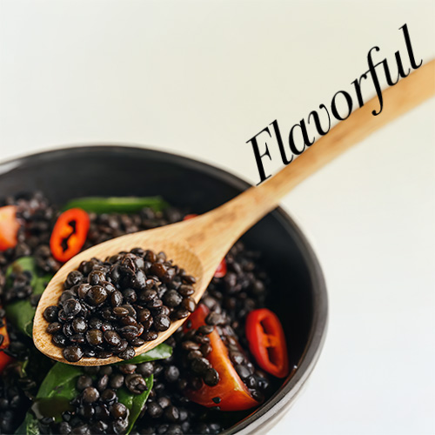
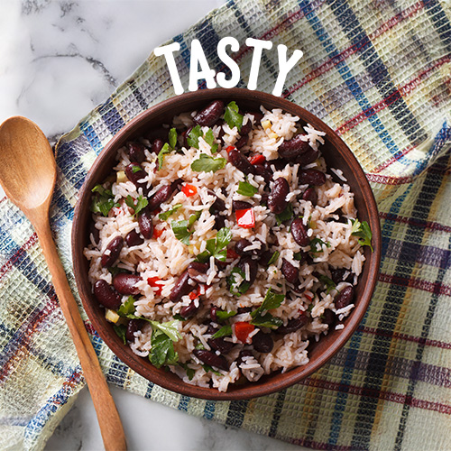
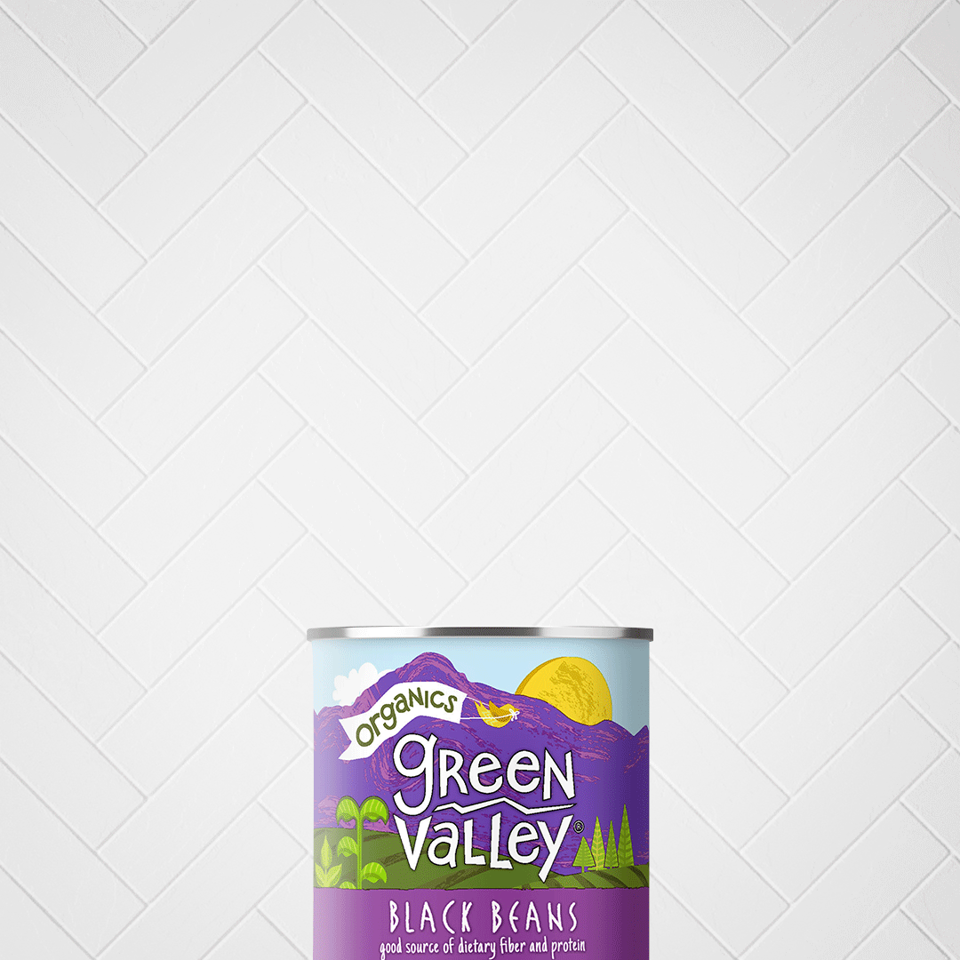

Slide 36
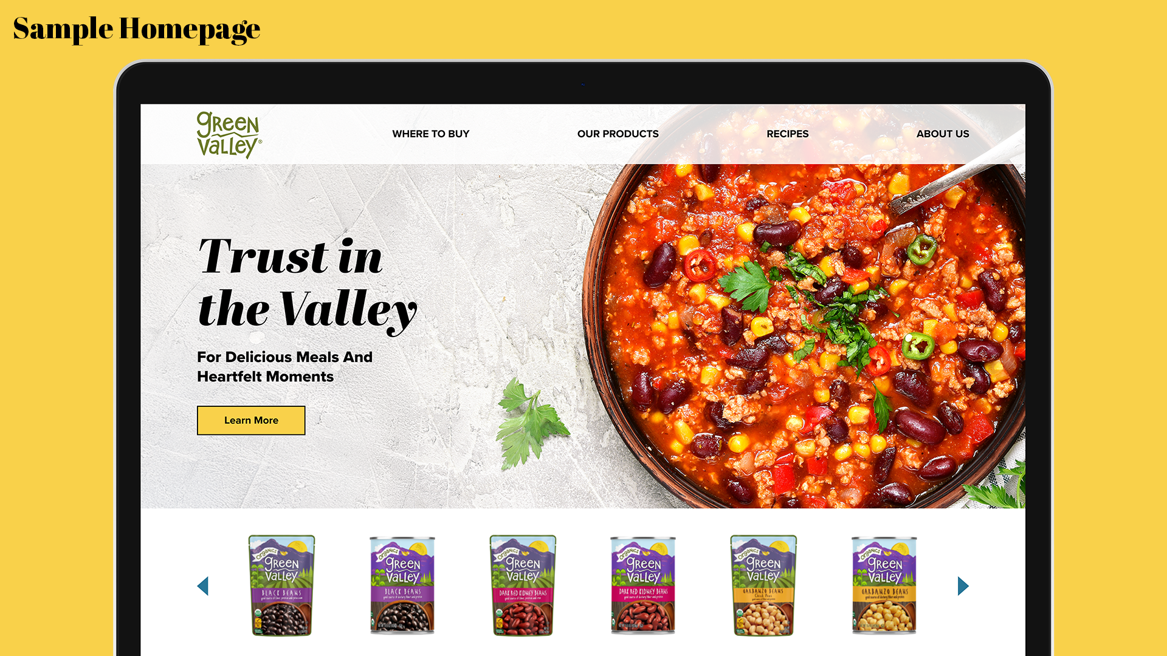

Slide 37

Tactical Execution:
"Look for the Valley"

Slide 38
Our Integrated Approach to Success
DX will increase brand awareness for Green Valley and build engagement through a multi-touch strategy that includes:
Paid Media:
Earned Media:
Owned Media:
Targeted advertising on social media, search engines, and relevant websites to reach specific consumer segments.
Influencer partnerships to build social media awareness and strengthen brand recognition through partnerships and storytelling.
Develop engaging content for Green Valley's website, blog, email, and social media channels to foster a strong online community.
Paid Media
Influencer/Recipe Creation
Social Media
Sweepstakes
Email Marketing
Blog Content
Enhanced Website

Slide 39



Paid Media Amplification
Goal 1
Goal 2
Drive brand awareness, website traffic, and affinity for Green Valley products via Digital Always-On channels.
Reinvigorate social channels via social boosting and engagement campaigns.
Retarget past website visitors, social followers/engagers, and video viewers to showcase the new brand awareness campaign by driving them back to the website.
Drive prospective site traffic via algorithmic targeting and look-a-like models, leading users to the explore page where they can find Green Valley products/locations. Add in retailer details where possible to drive foot traffic in stores.
Focus on applicable unbranded beans/veggie keywords while SEO builds relevancy. Align keyword strategy to recipe development to promote ingredients that are seasonal and top of mind.
Boost social posts via social engagement campaigns to ensure that fans of Green Valley see the latest content while continuing to grow the community. These ads add social proof and populate Facebook retargeting pools.
Gain access to place paid promotion behind recipe creation/influencer content to gain further exposure to recipes that use Green Valley products.
15%
Budget
30%
Budget
30%
Budget
15%
Budget
10%
Budget

Slide 40

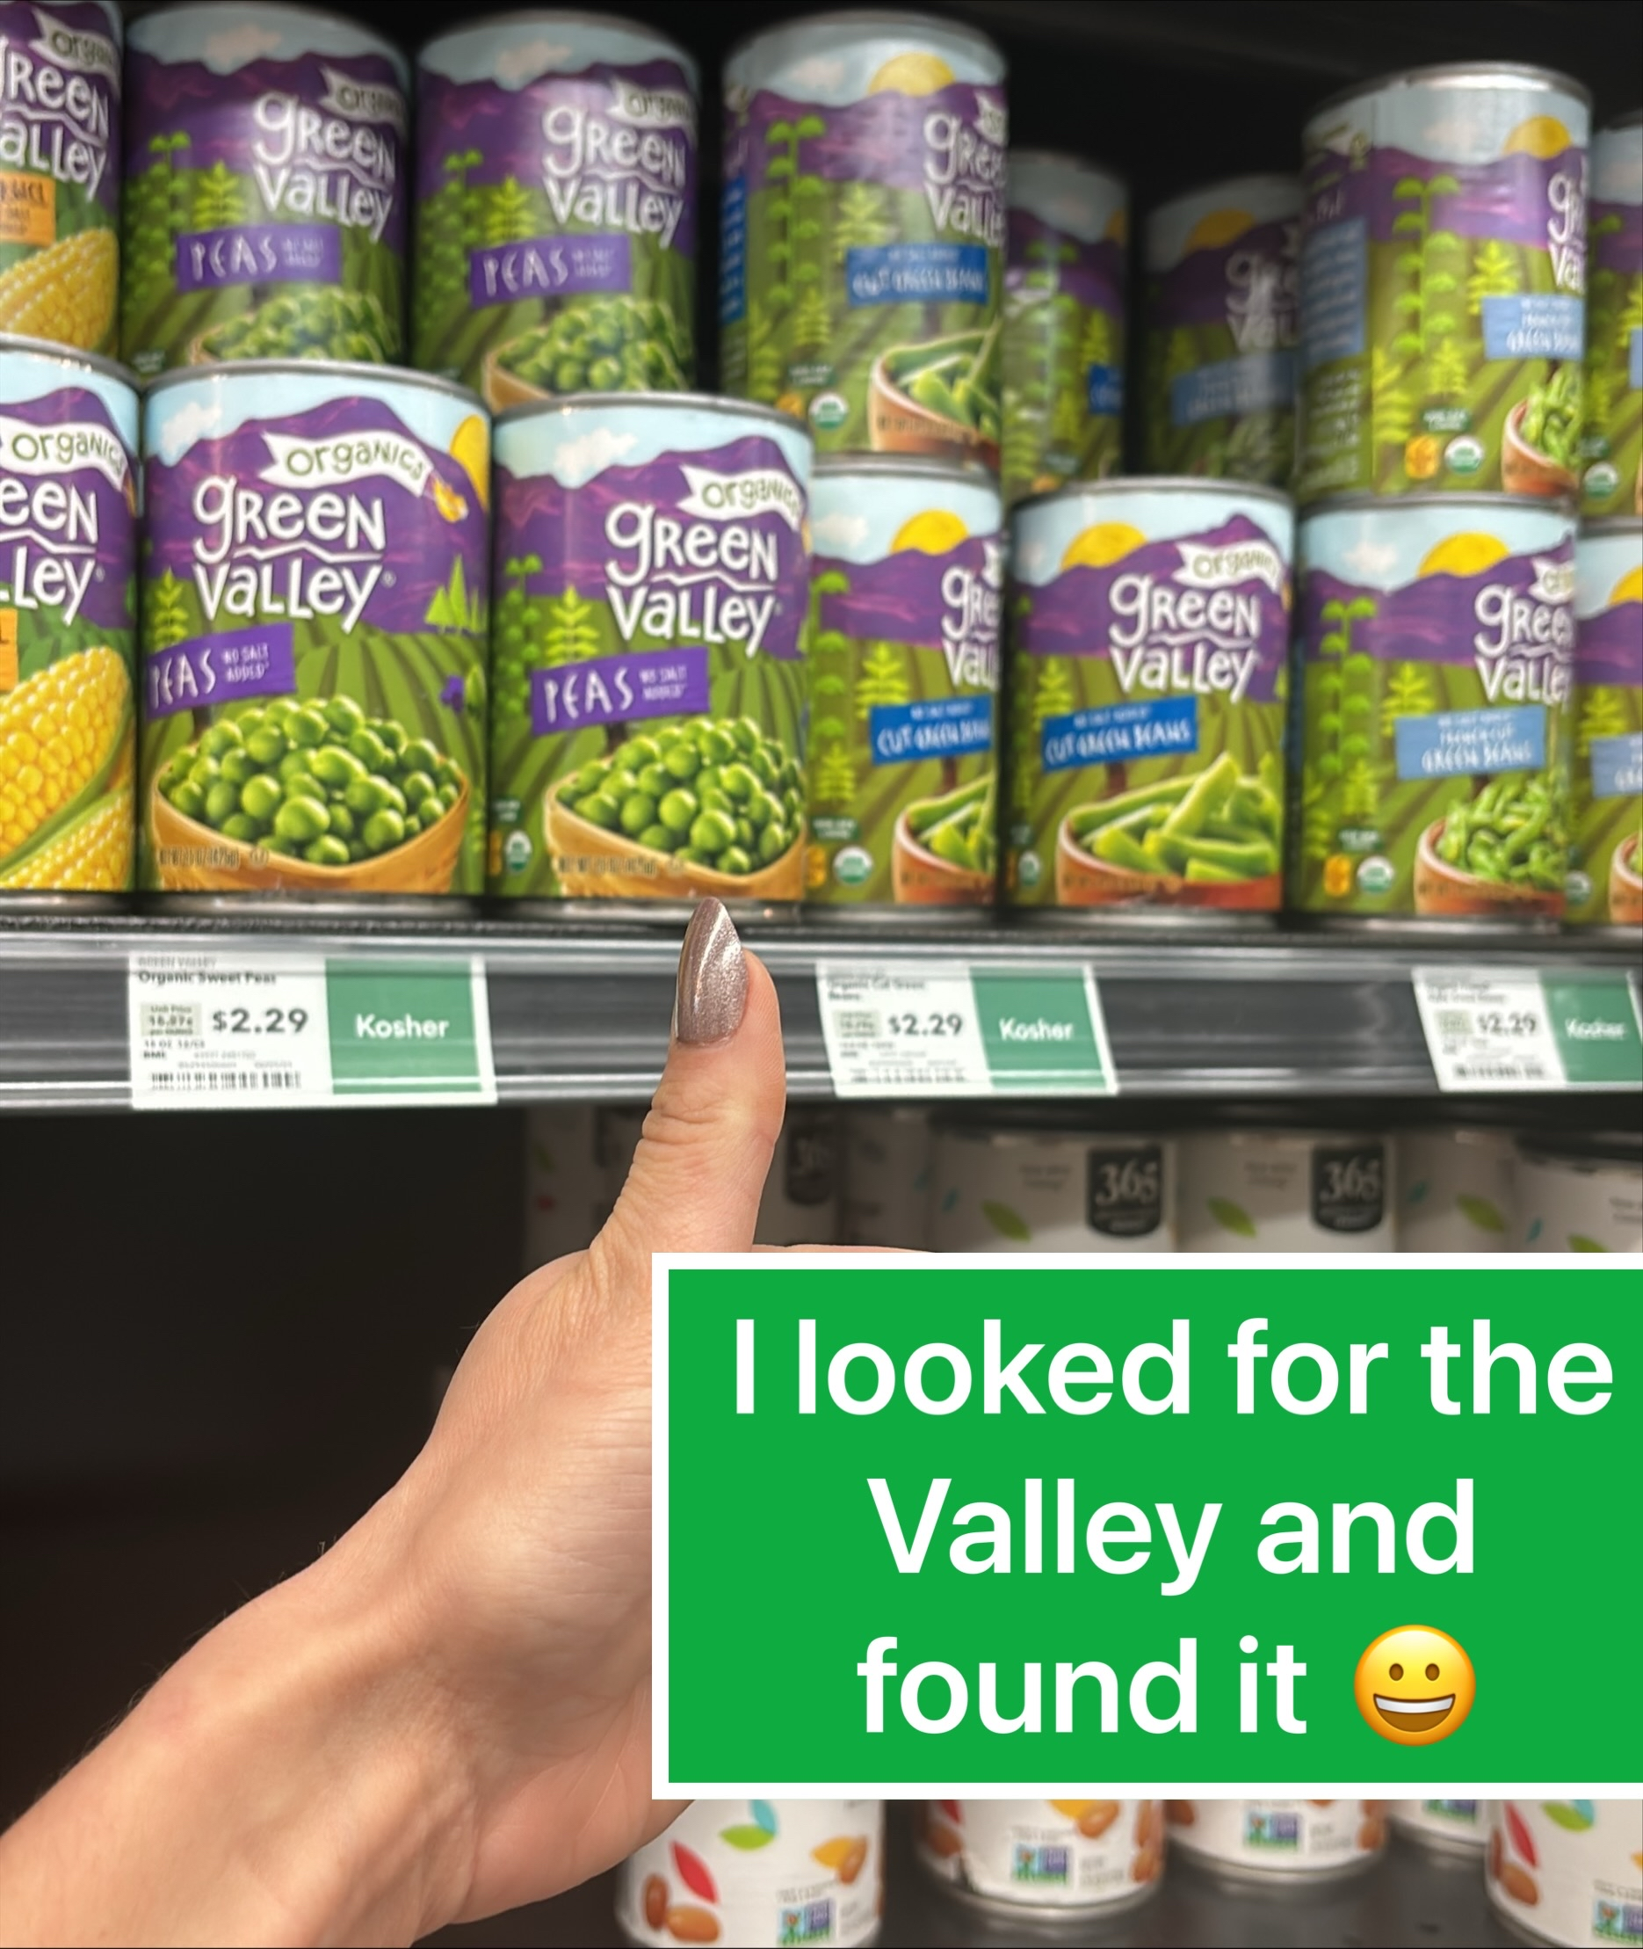
Influencer Recipe Collaboration:
Look for the Valley Content Series
Influencer: @dishitgirldina
As part of the Look for the Valley campaign, our influencer will take followers on a journey through the grocery aisle—showing them exactly how to find Green Valley Organics among a sea of organic options.
Through engaging in-store content, she’ll highlight what makes Green Valley Organics different and why it’s the trusted choice for clean, high-quality ingredients.
Objective: Drive brand engagement and product usage through compelling recipe content.
12 Original Recipes: Fresh, seasonal creations developed and launched monthly across all platforms.
Rich Content Package (Per Recipe):
  6 High-Res Images (retouched)
  1 Social Media Video/Reel
  Recipe Word Document
  Social Media Posts & Captions (on brand & influencer page)
Annual Content Distribution:
  12 Website Recipe Posts
  12 Monthly Recipe Round-Up Blog Posts
  Enhanced Recipe Landing Page

Slide 41
Social Media Management & Reinvigoration
Our social media presence is more than just posts—it’s about building a movement around fresh, organic choices and guiding consumers to Look for the Valley every time they shop. Through strategic content, influencer collaborations, and community engagement, we’ll make Green Valley Organics a go-to brand across Facebook, Instagram, and Pinterest.
Social Media Strategy & Execution
Strategic Content Calendar & Posting
5 posts per week across Facebook & Instagram, blending:
Static images that highlight product benefits and brand storytelling.
Instagram Stories to drive daily engagement and in-the-moment interactions.
Reels featuring influencer recipe creations, in-store shopping experiences, and real-life uses of Green Valley Organics.
Pinterest-friendly visuals to inspire home cooks and drive website traffic.
Bringing Look for the Valley to Life
Content will showcase influencers shopping for Green Valley in grocery aisles, educating consumers on what to look for and why it matters.
Recipe posts will bring real-life applications to Green Valley’s organic products, guiding consumers from the aisle to the kitchen.
Engaging captions will reinforce the brand’s commitment to transparency, quality, and organic integrity.
Light Community Management & Engagement
Responding to comments, DMs, and questions to build a loyal, engaged community.
Encouraging user-generated content on how they found the valley by resharing customer photos, recipes, and experiences.
Monitoring trends and adjusting content based on real-time engagement.
Monthly Reporting & Insights
Data-driven reports covering:
Trends in consumer engagement.
Best-performing content to optimize future posts.
Opportunities for growth and community expansion.

Slide 42
Look for the Valley UGC Sweepstakes
Drive In-Store Traffic & Boost Brand Awareness with our Engaging Sweepstakes
Objective: Increase foot traffic into retail stores, encourage product discovery, and drive purchase consideration of Green Valley Organics products.
Sweepstakes Overview:
Duration: 3+ months to kick off
Entry Method: Participants visit a participating store, locate Green Valley products, and share their shopping experience for a chance to win.
Bonus Entries: Maximize engagement with these bonus entry opportunities:
  Product Photo: Upload a photo with a Green Valley product.
  Shopping Haul: Share a photo of your shopping haul, including Green Valley items.
  Recipe Share: Share a favorite recipe made with Green Valley products.
  Social Sharing: Share the sweepstakes with friends and family.
  Follow Us: Follow Green Valley on Instagram.

Slide 43
Email Strategy*: Guiding Consumers to
Look for the Valley
Our email marketing approach ensures Green Valley Organics stays top of mind for consumers, providing them with seasonal inspiration, product education, and exclusive content that reinforces why they should always Look for the Valley.
Email Strategy & Execution
6 Emails Per Year (One Every Two Months)
  Each email will have a clear purpose—whether it’s introducing a new recipe, sharing seasonal tips, highlighting an influencer feature, or reinforcing Green Valley’s brand values.
Content will include:
  Grocery Aisle Insights: How to spot high-quality organic canned vegetables and why Green Valley stands out.
  From the Aisle to the Kitchen: New influencer-created recipes featuring Green Valley Organics in easy, delicious meals.
  Sustainability & Transparency: Reinforcing our commitment to organic integrity, and clean ingredients.
Quarterly Reporting & Optimization
Performance tracking to measure open rates, click-through rates, and engagement trends.
Insights to refine subject lines, content strategies, and audience segmentation for stronger results.
*Not an element in the RFP but DX believes this is an important channel to maintain and grow engagement with new and prospective customers.

Slide 44

SEO Optimized Green Valley Blog
A strong SEO content strategy ensures that Green Valley Organics appears first when consumers search for organic food, healthy recipes, or clean eating tips. By creating optimized blog content, refining categories and tags, and leveraging search intent, we drive more organic traffic to the site while reinforcing why Green Valley is the trusted choice.
SEO Blog Strategy & Execution
Creating new blog categories & tags for better search visibility.
Structuring content to align with high-intent search terms and user needs.
Conduct keyword research for relevant terms.
Internal linking to relevant recipes, products, and educational pages.
SEO-Optimized Blog Post Per Month
Each blog post will be strategically written to:
Target relevant keywords with strong search volume.
Answer real consumer questions and drive organic traffic.
Link to key Green Valley product pages to boost conversions.
Integrate influencer recipes for real-life application.
Encourage readers to Look for the Valley.

Slide 45
Green Valley Website Maintenance:
Keeping the Valley Fresh
Our website is the digital front door to Green Valley Organics, and just like our commitment to fresh, high-quality ingredients, we ensure our online presence stays fresh, engaging, and relevant. Through ongoing updates and content enhancements, we make it easier for consumers to Look for the Valley—both in-store and online.
Ongoing Website Maintenance Includes:
Aligning the Website with the "Look for the Valley" Creative Concept
  Regular updates and refreshes to the site’s design and messaging to ensure it stays aligned with the evolving brand identity and creative strategy.
Consistently Fresh Content & Visuals
  One new blog post per month to educate, inspire, and reinforce our commitment to real, organic food.
  One new recipe update per month featuring influencer-created meals, ensuring the recipe page stays fresh and relevant.
SEO Optimization & Structured Data Enhancements
  Implementing SEO schema markup across the site to enhance search engine visibility and improve ranking.
  Ongoing site optimization efforts (up to one per month) to refine performance, speed, and UX based on analytics and insights.
Regular Site Health Monitoring & Technical Maintenance
  Ongoing site performance checks, bug fixes, and functionality improvements to ensure a smooth experience.
  Security updates, plugin maintenance, and overall website health monitoring.

Slide 46
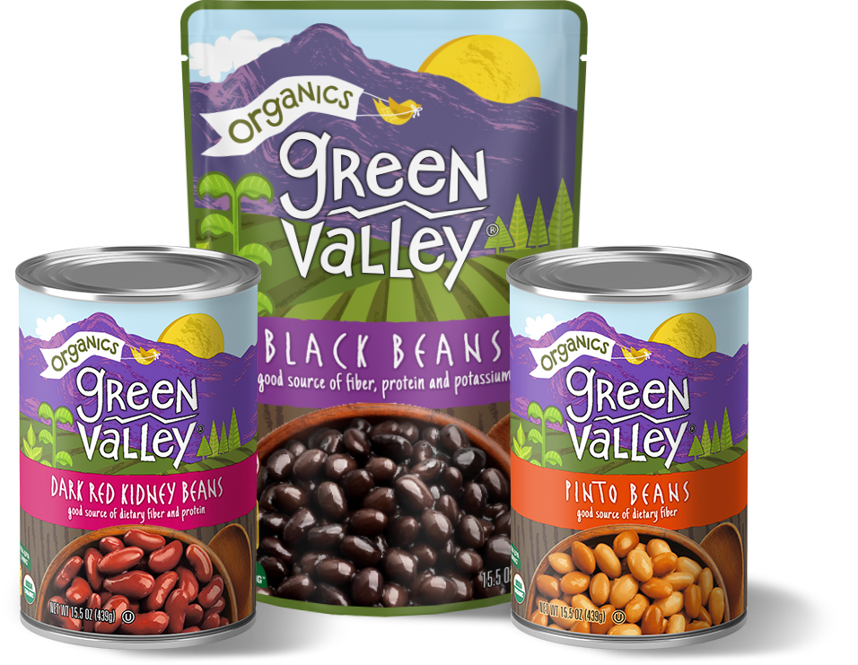
Pricing
The $250,000 yearly budget will be allocated below to support an always-on digital brand awareness campaign, refreshed creative approach, reinvigorated social media pages, and influencer partnerships, as well as unique recipe development and SEO optimizations for the Green Valley Blog, website, and content strategy.
Paid Media | $100k gross (inclusive of media fee)
Influencer Recipe Development | $18,000/yr
Monthly Retainer Fee: Account Management Website Maintenance & Management 1 email (every 2 months) / 6 total 1 blog post per month / 12 total 20 social posts per month (FB, IG, Pinterest) Ongoing SEO Ongoing Community Management 1 UGC Sweepstakes | $132k/yr ($11,000/month)
Total: | $250,000

Slide 47

Your Strategic Marketing Partner
Blending audience insights, technology, and creative strategy, DX crafts meaningful, results-driven solutions. While digital is our sweet spot, we go beyond platforms to create real connections. Our team thrives on collaboration, combining human creativity with smart tech to drive long-term success. Simply put, we have your back—DX is on it.
Meet Your Team
Natalie Folgar
Sr. Director, Strategy
Adrienne Callandrello
Director, Integrated Marketing
Ashley De Peri
Vice President, Creative Director
Nancy Cozine
Sr. Director, Content
Roeni Alexandra Abreu
Sr. Manager, Content
Chris Orsino
Senior Coordinator, Accounts
Notes:
Move down, emphasize team staying the same who know the brand and bringing in SMEs.
LOWER IN THE DECK

Slide 48
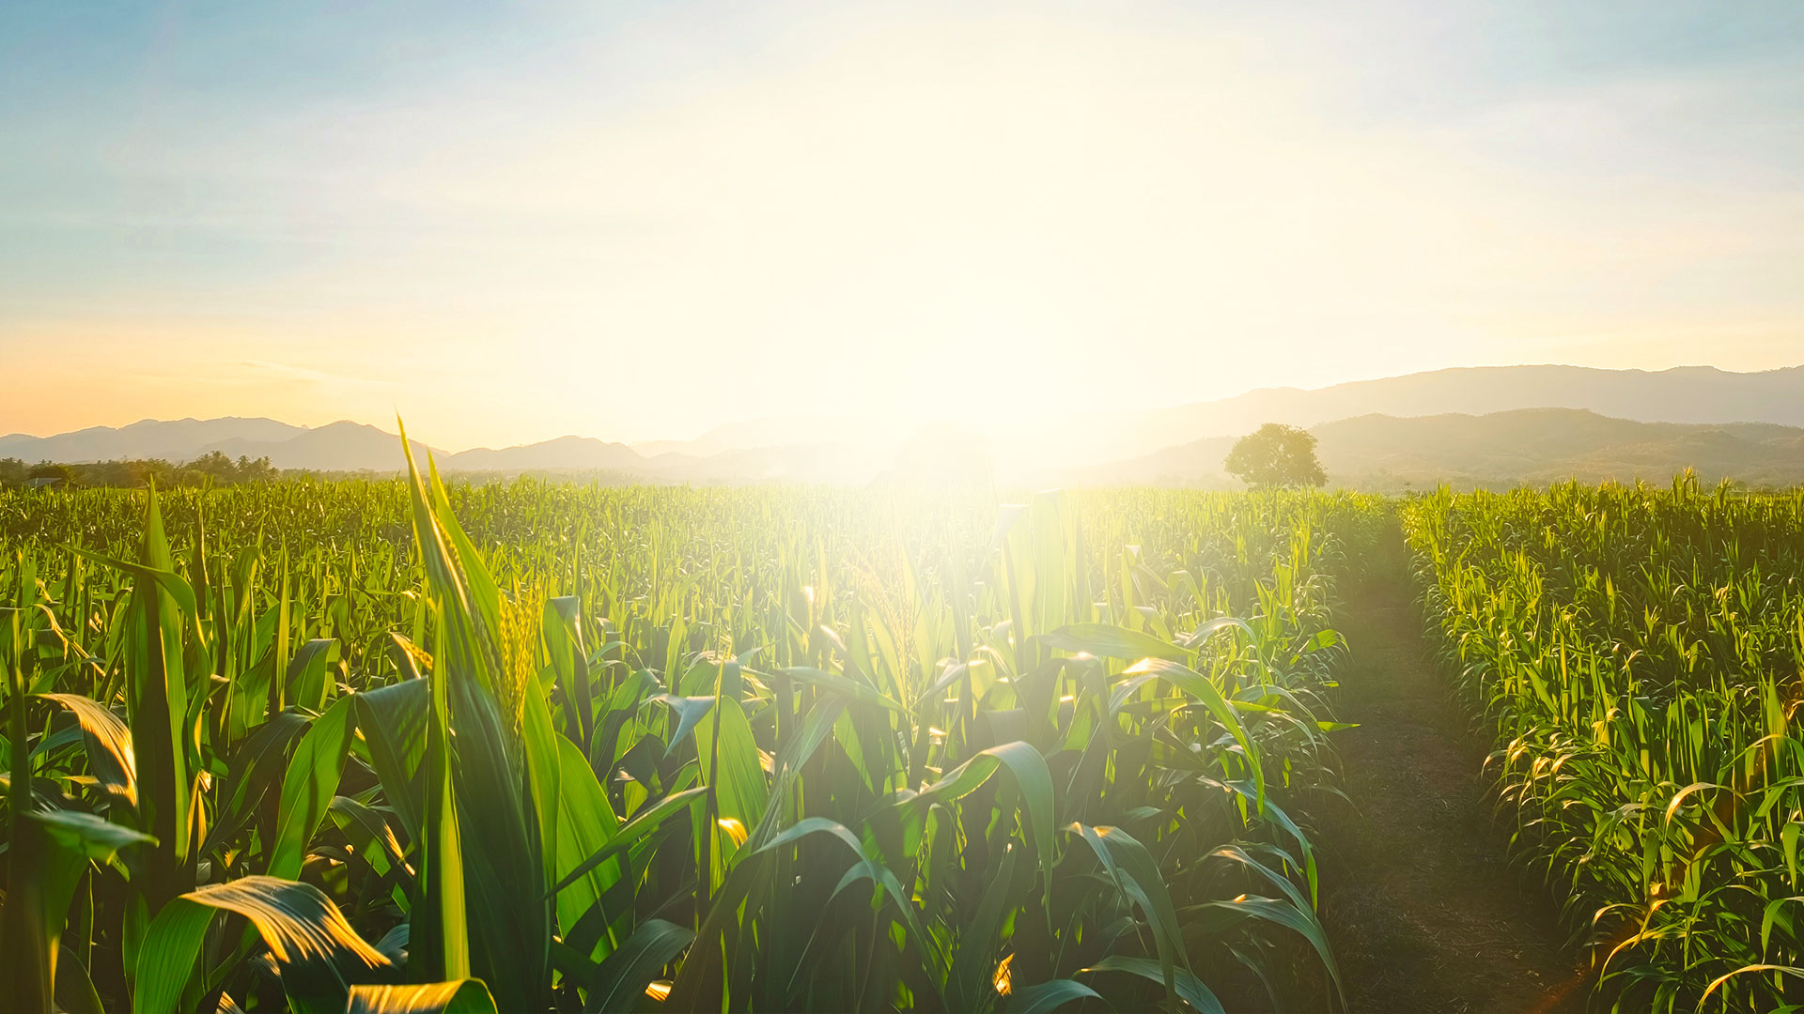

Thank you!

